Slide 1
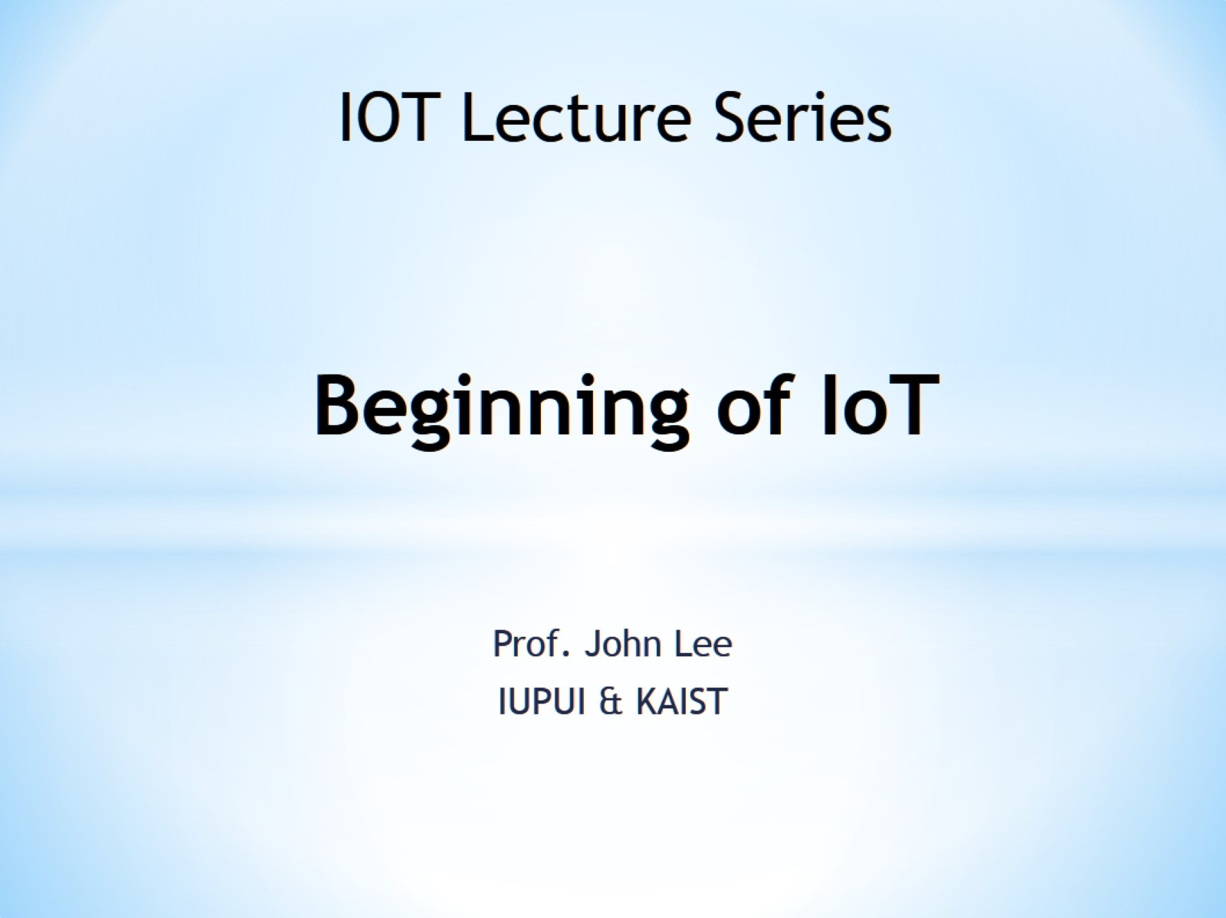
Beginning of IoT

Slide 2

Slides can be found from

Slide 3
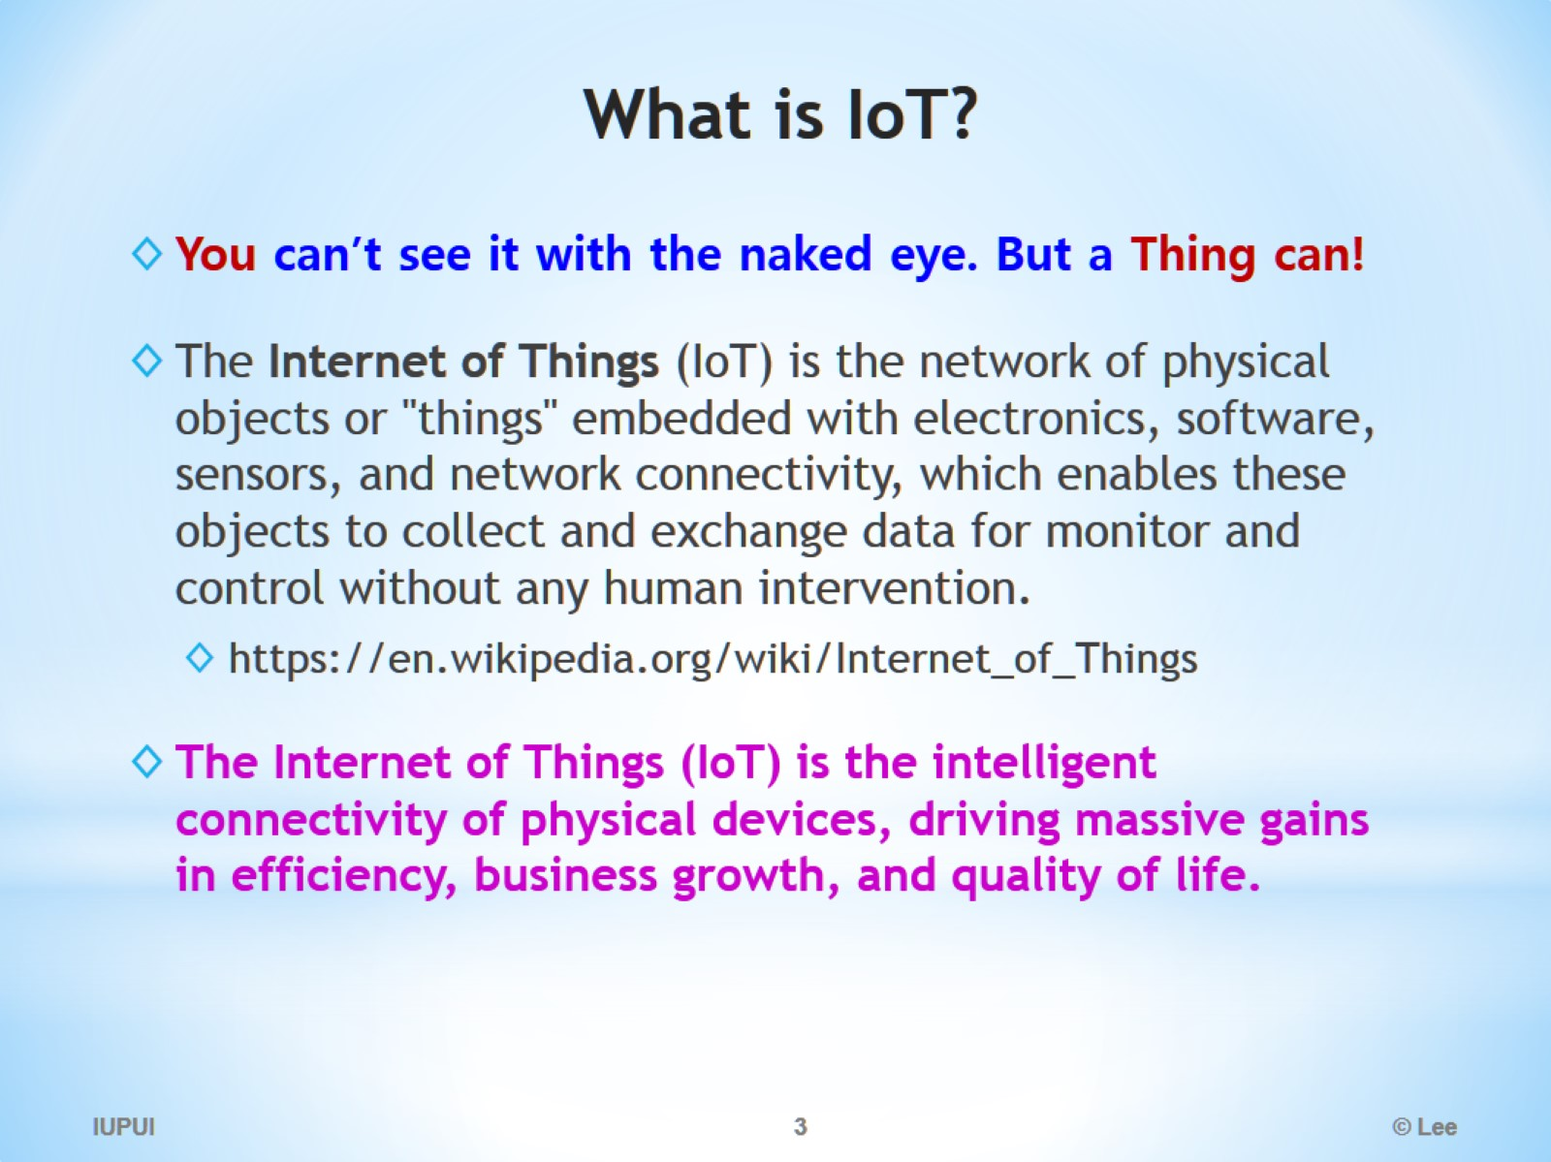
What is IoT?

Slide 4
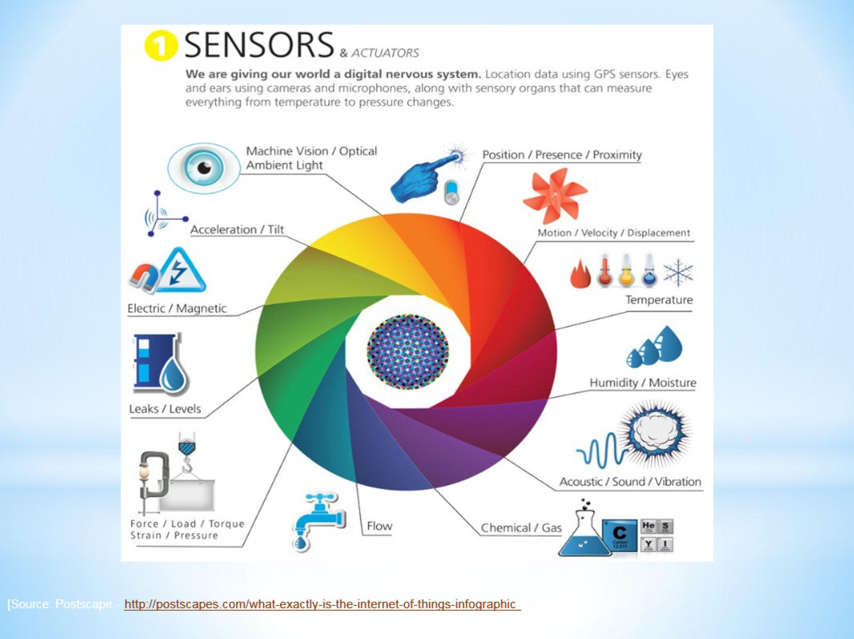

Slide 5
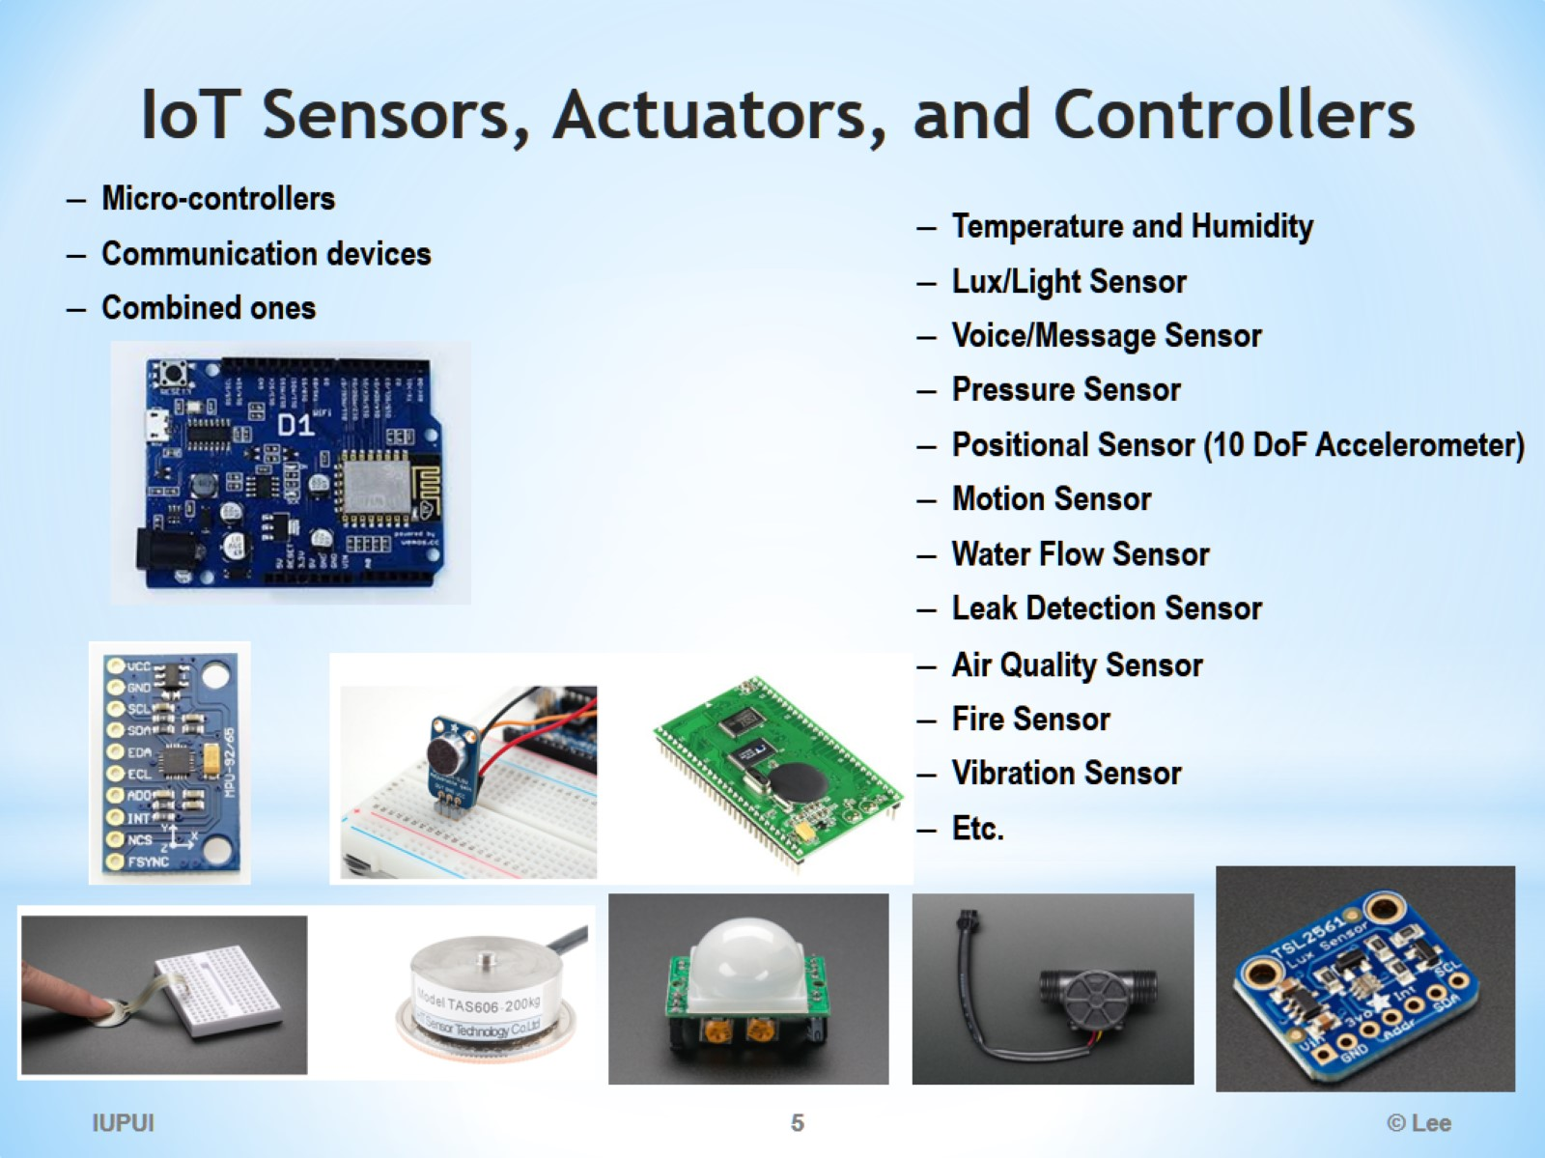
IoT Sensors, Actuators, and Controllers

Slide 6
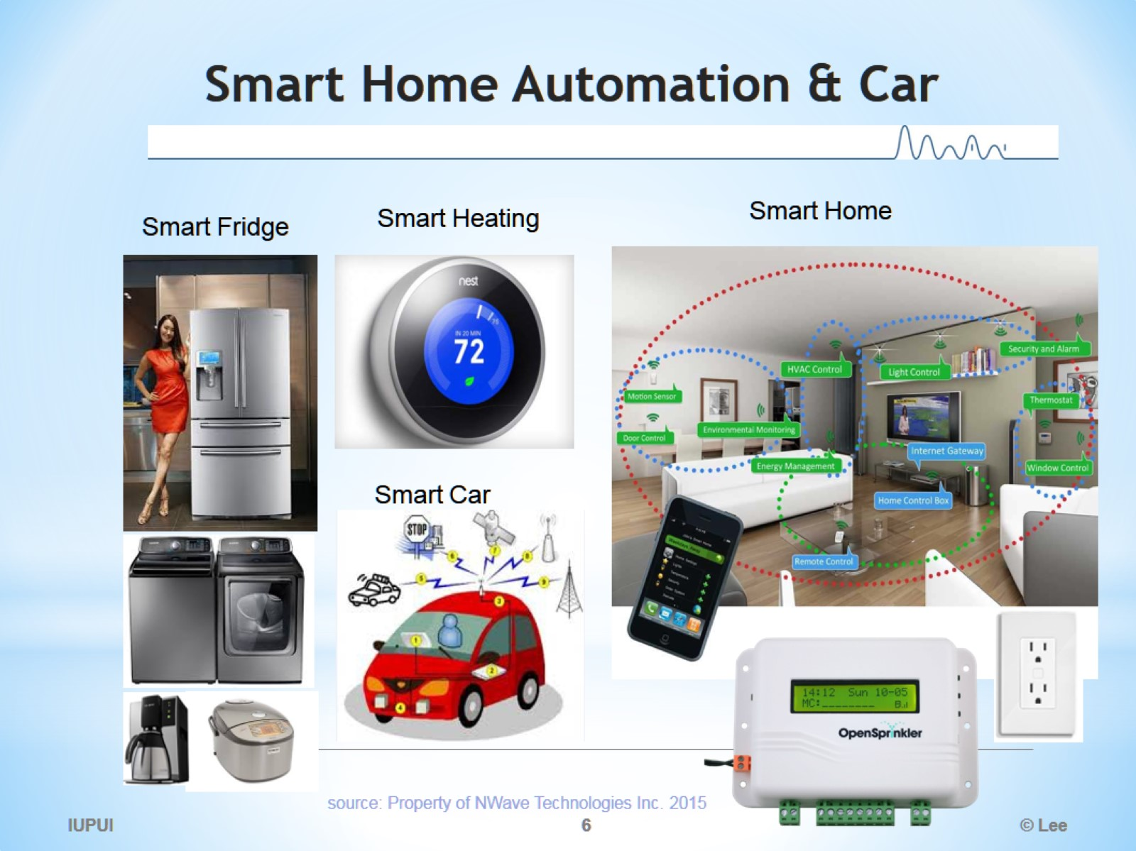
Smart Home Automation & Car

Slide 7
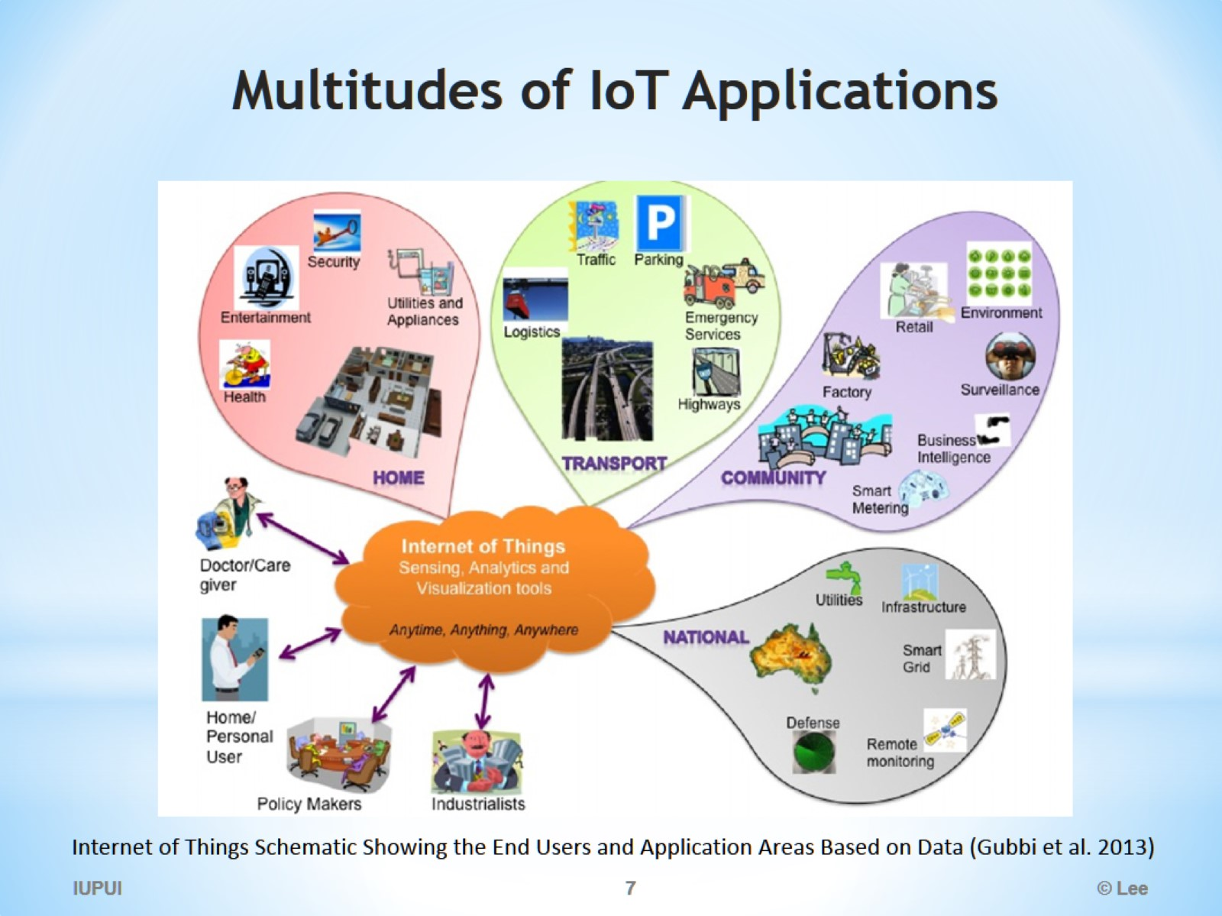
Multitudes of IoT Applications

Slide 8
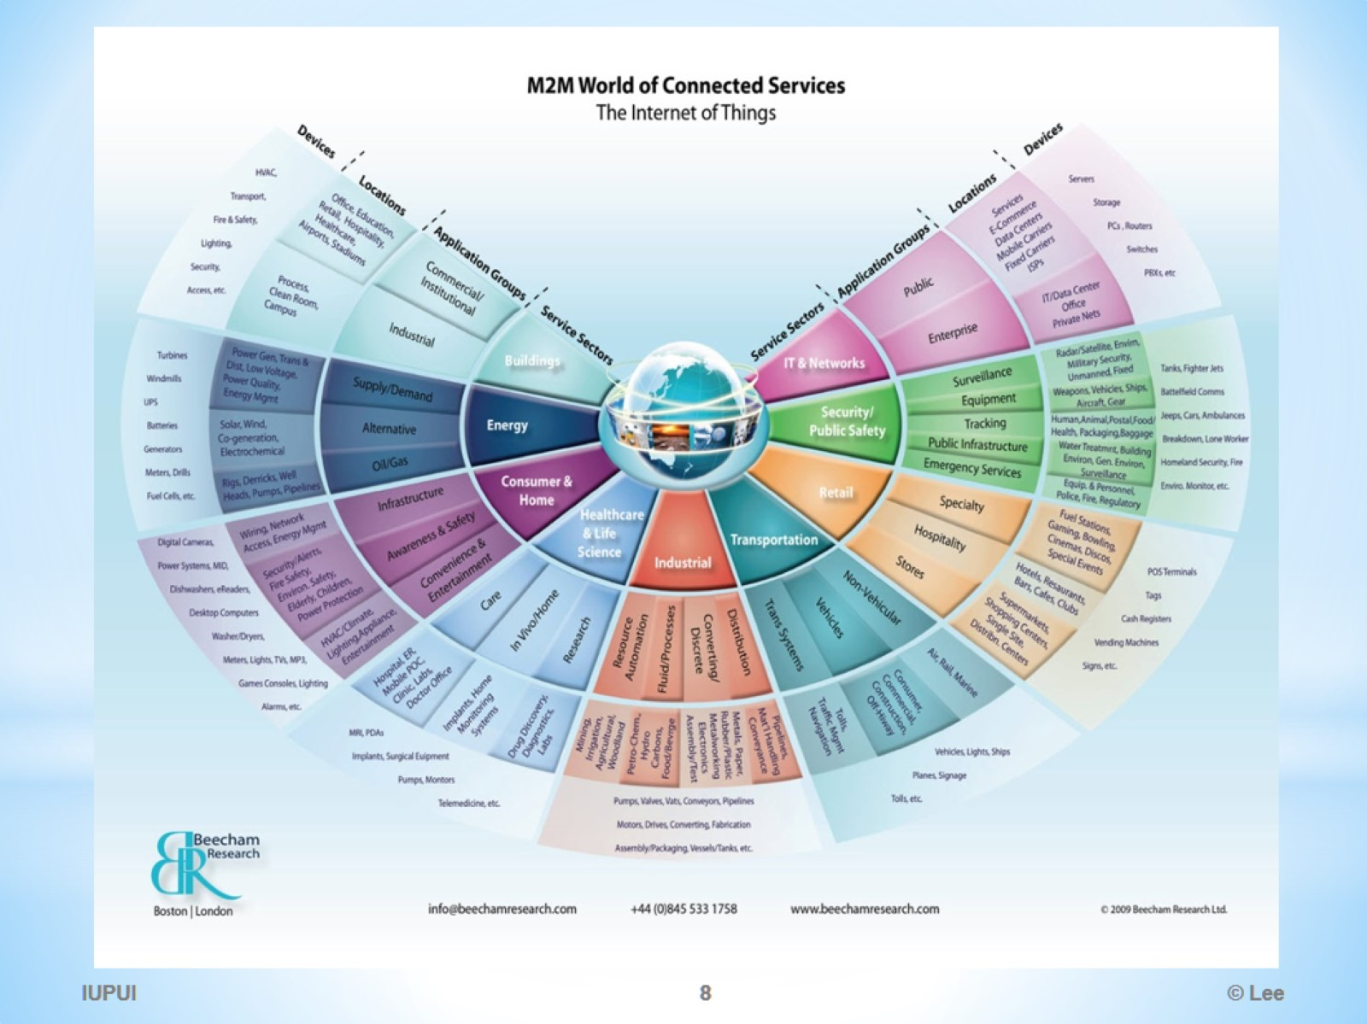

Slide 9
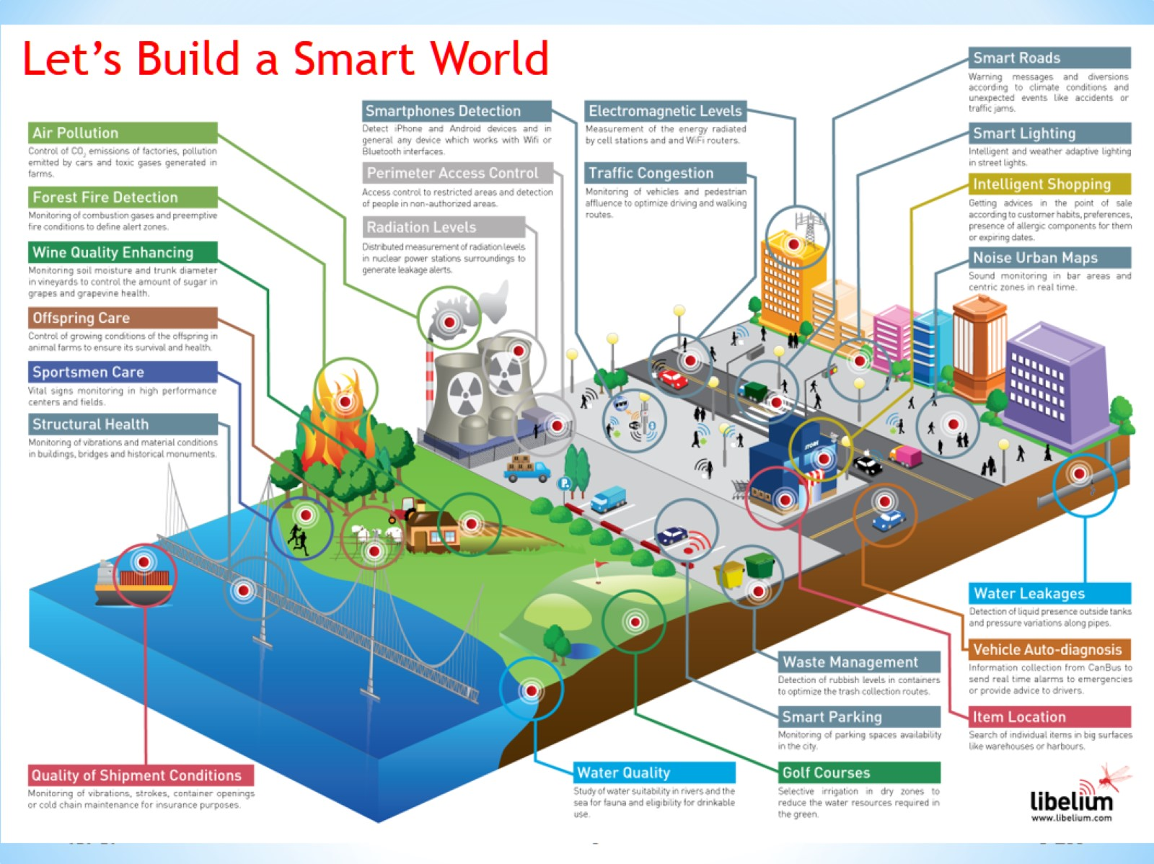

Slide 10
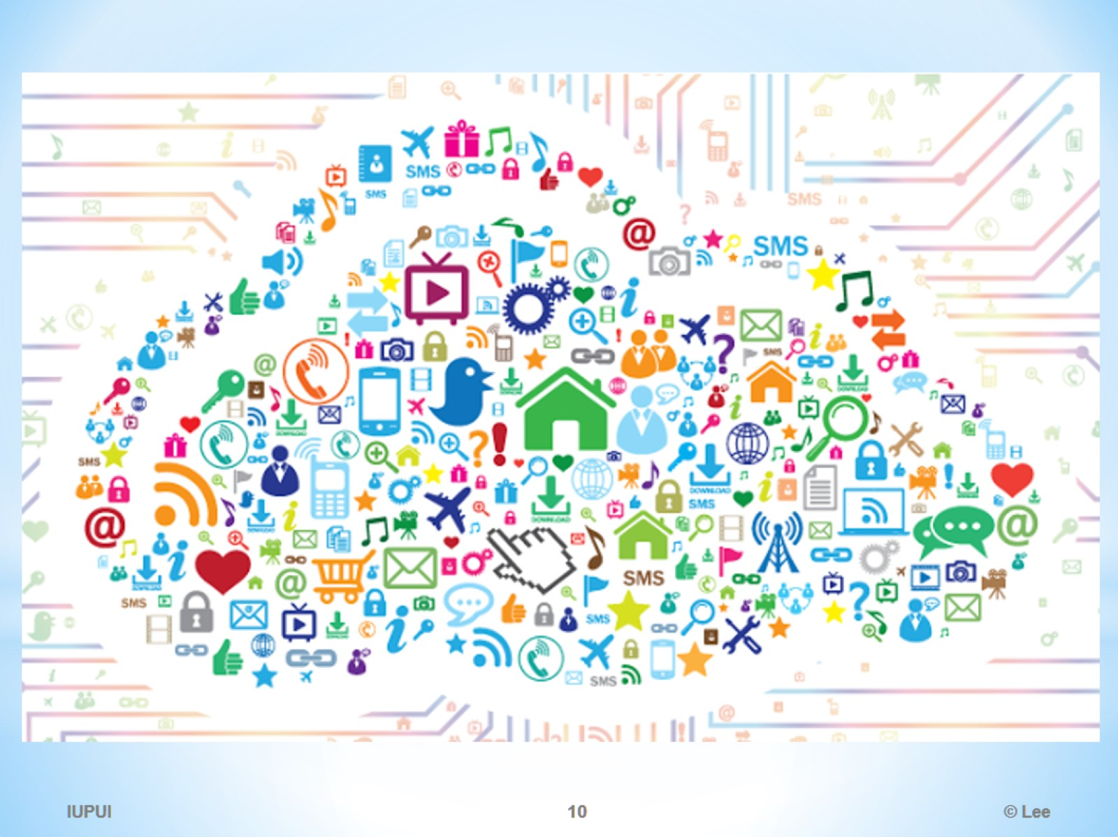

Slide 11
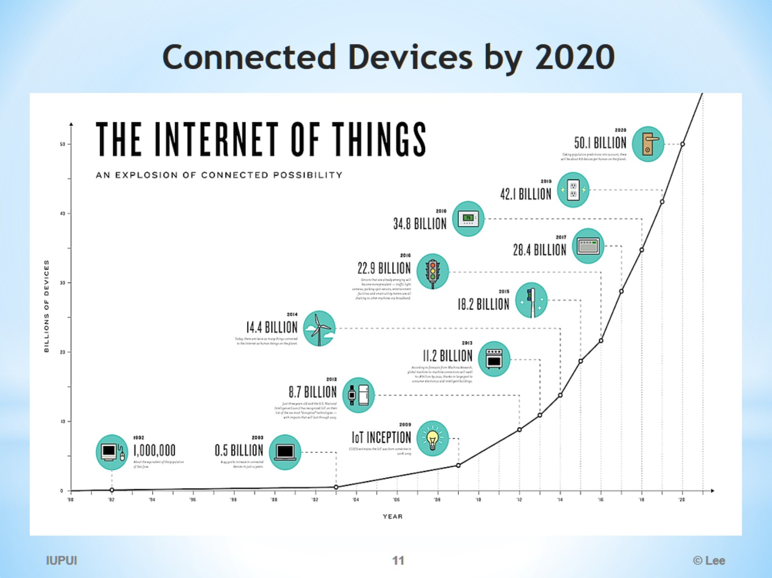
Connected Devices by 2020

Slide 12
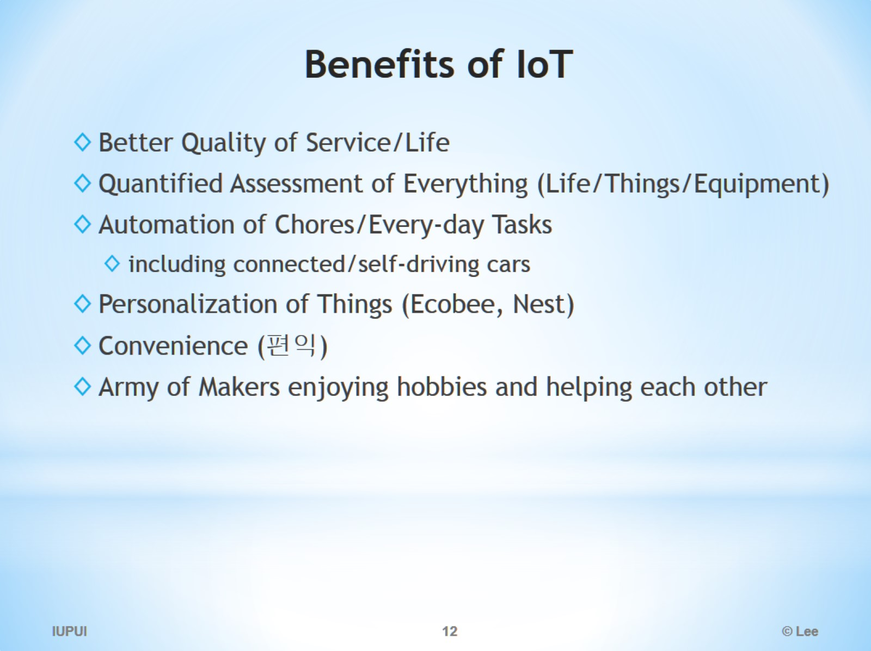
Benefits of IoT

Slide 13
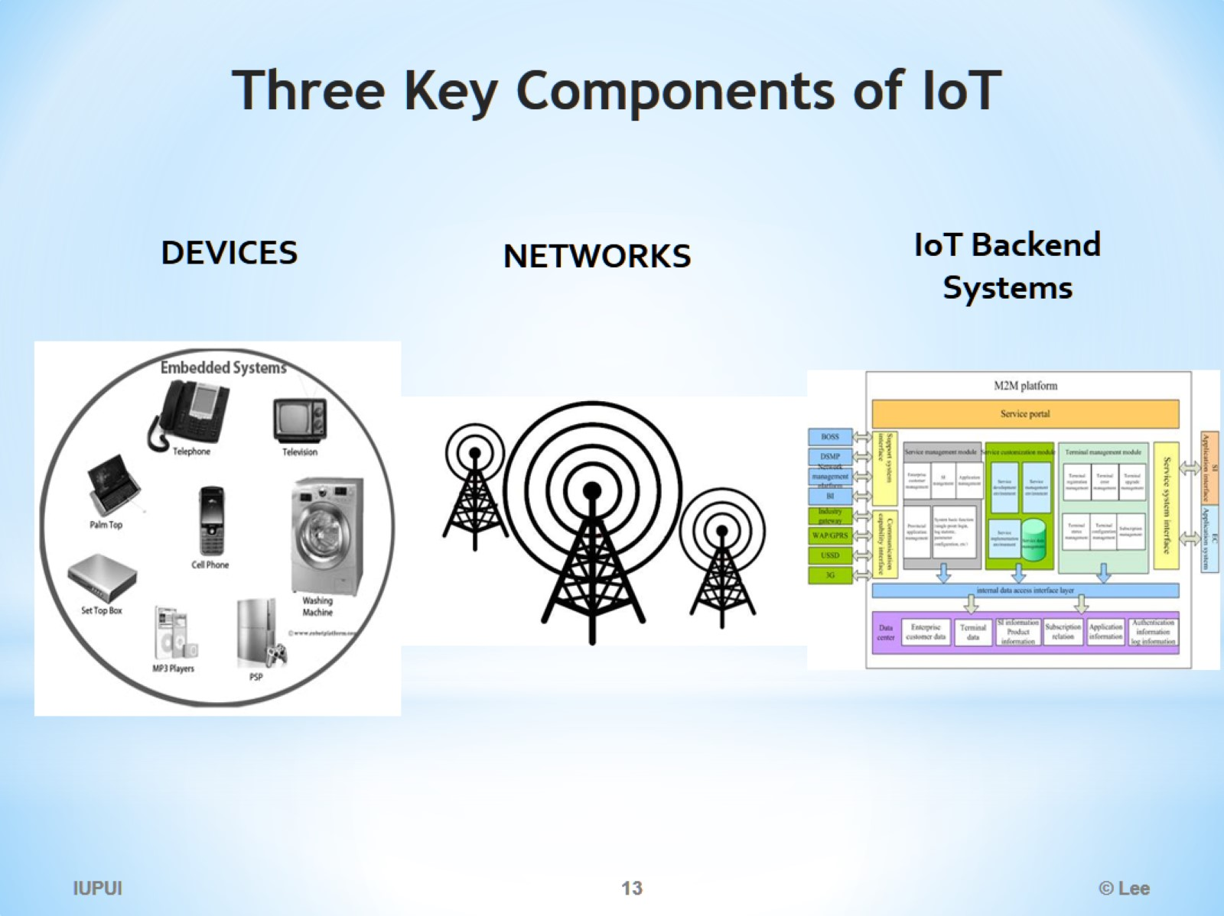
Three Key Components of IoT

Slide 14
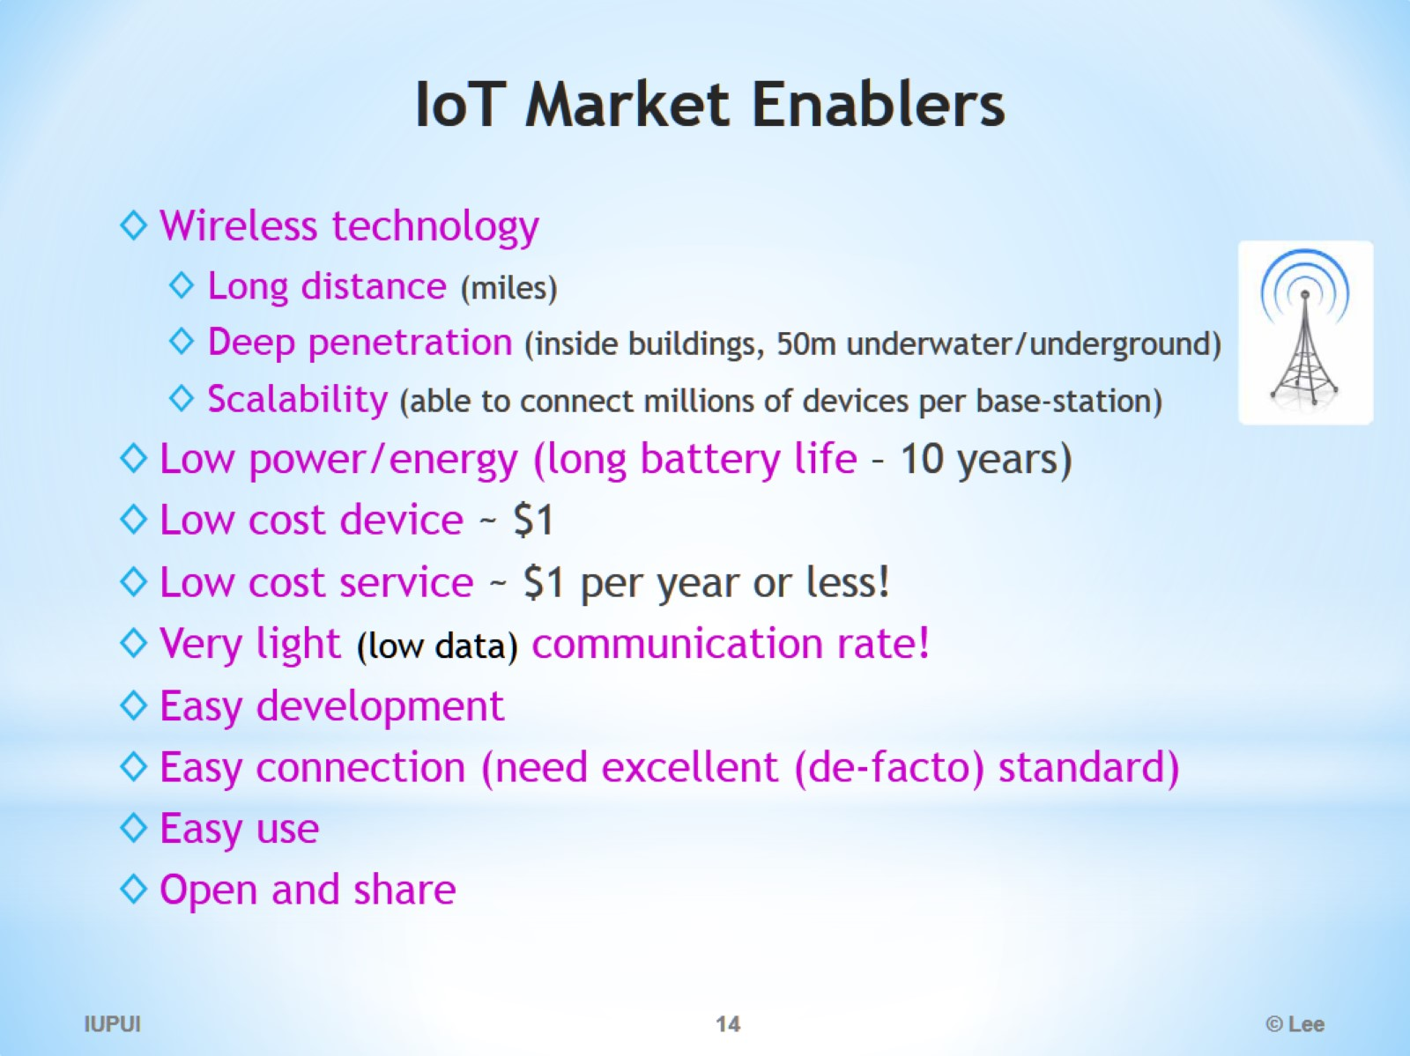
IoT Market Enablers

Slide 15
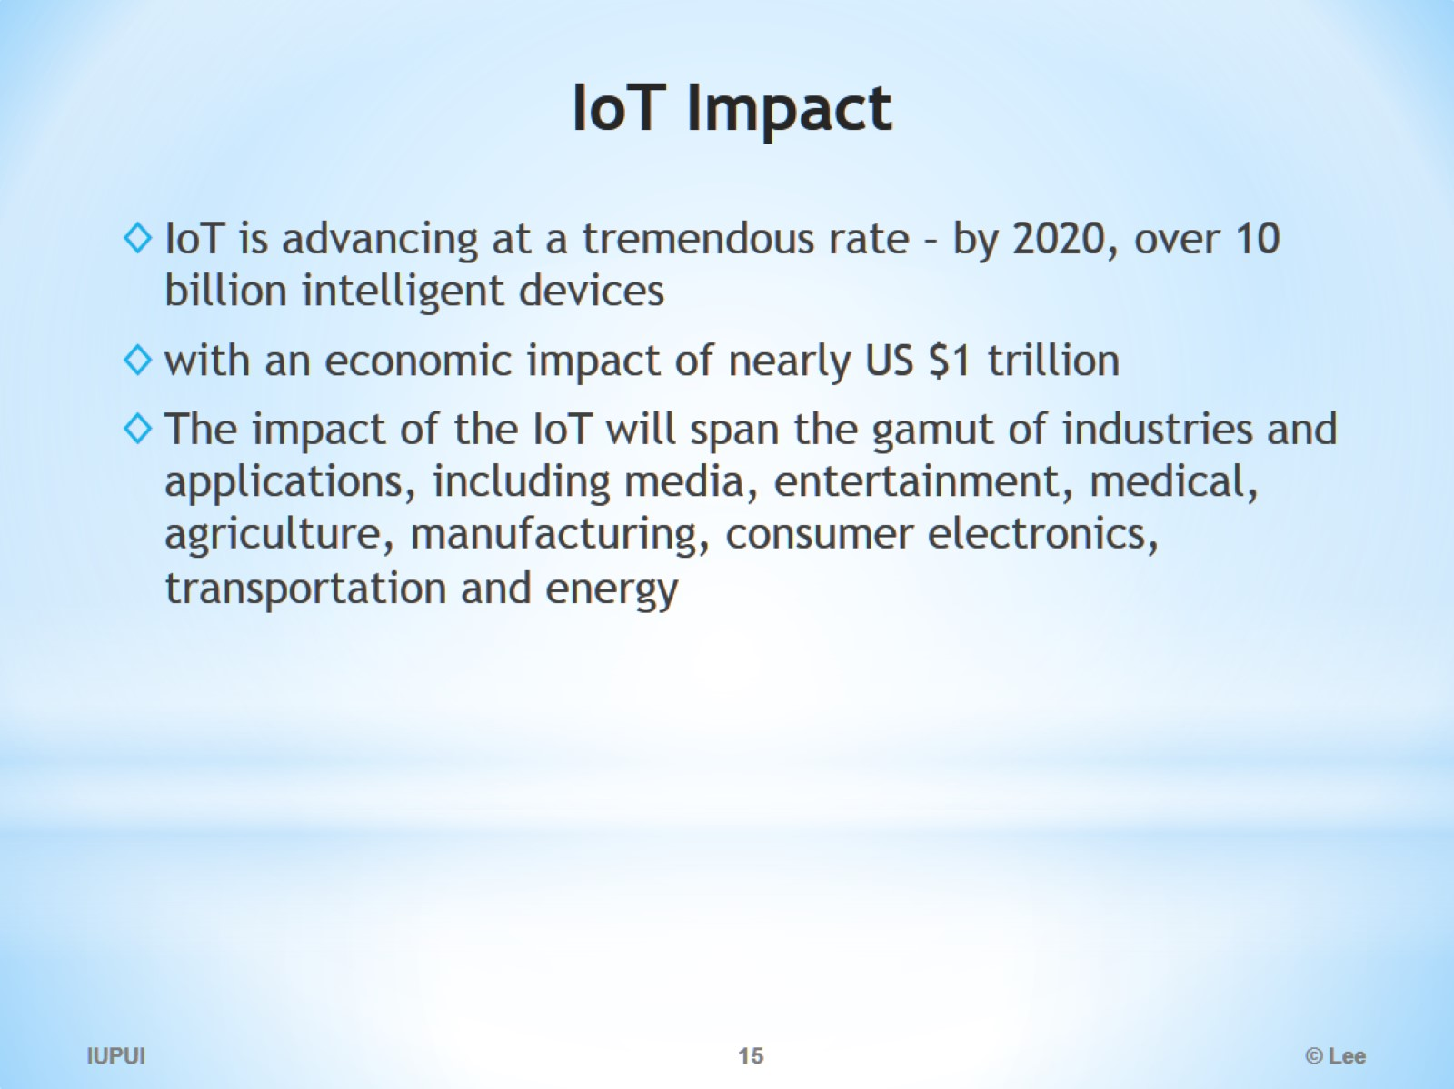
IoT Impact

Slide 16

It is all made possible thanks to Open Source evolution

Slide 17
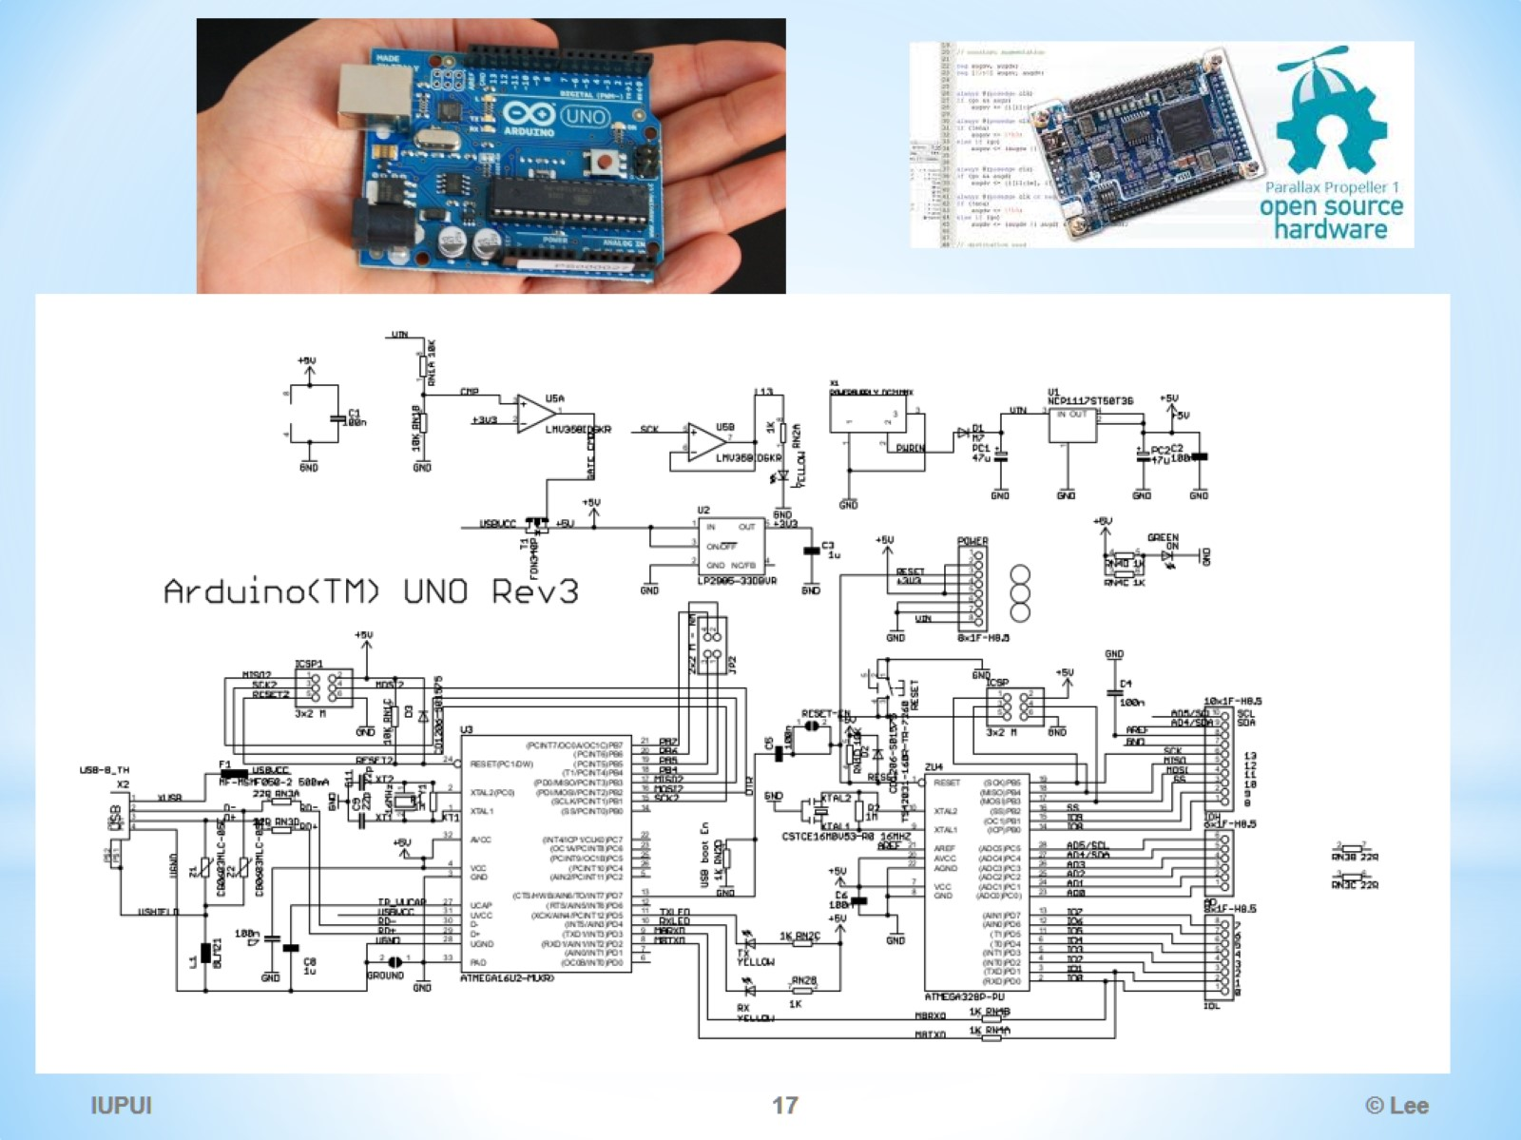

Slide 18
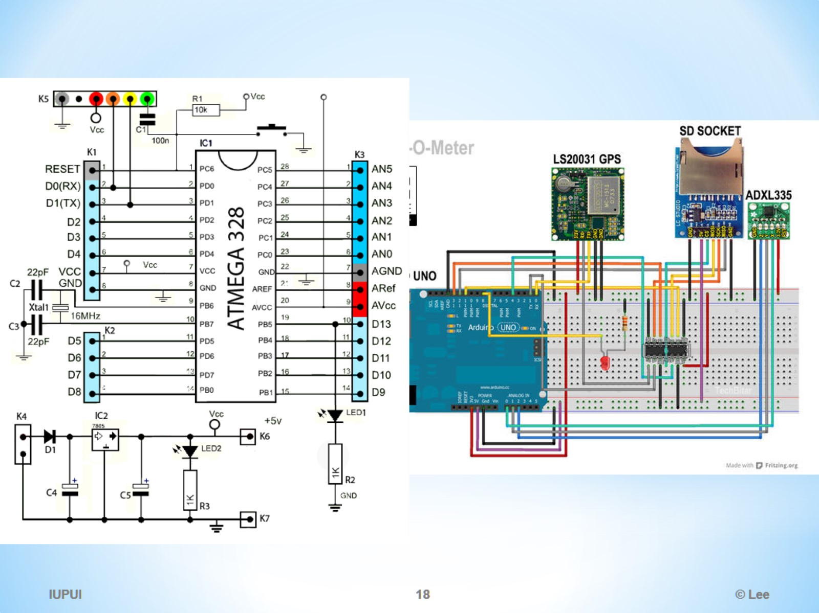

Slide 19
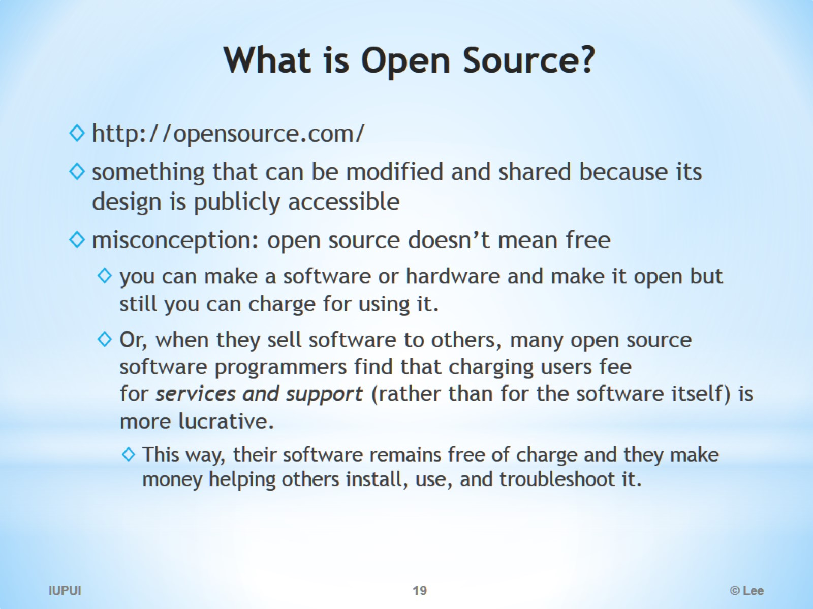
What is Open Source?

Slide 20
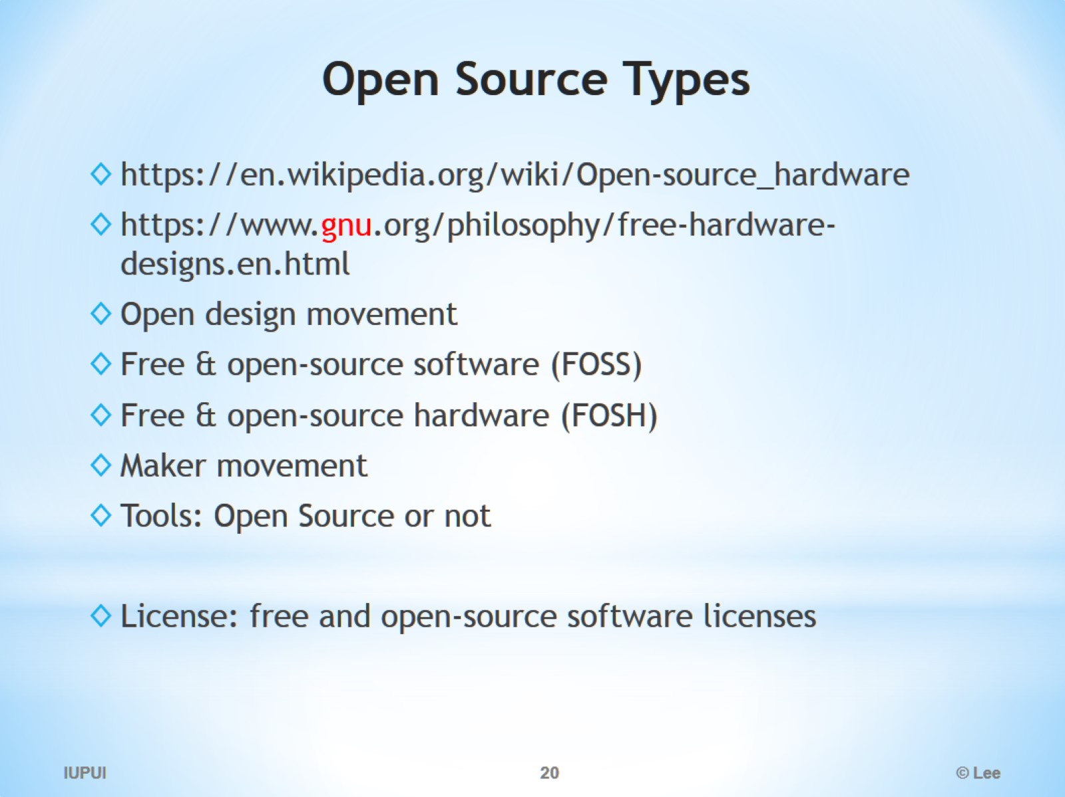
Open Source Types

Slide 21
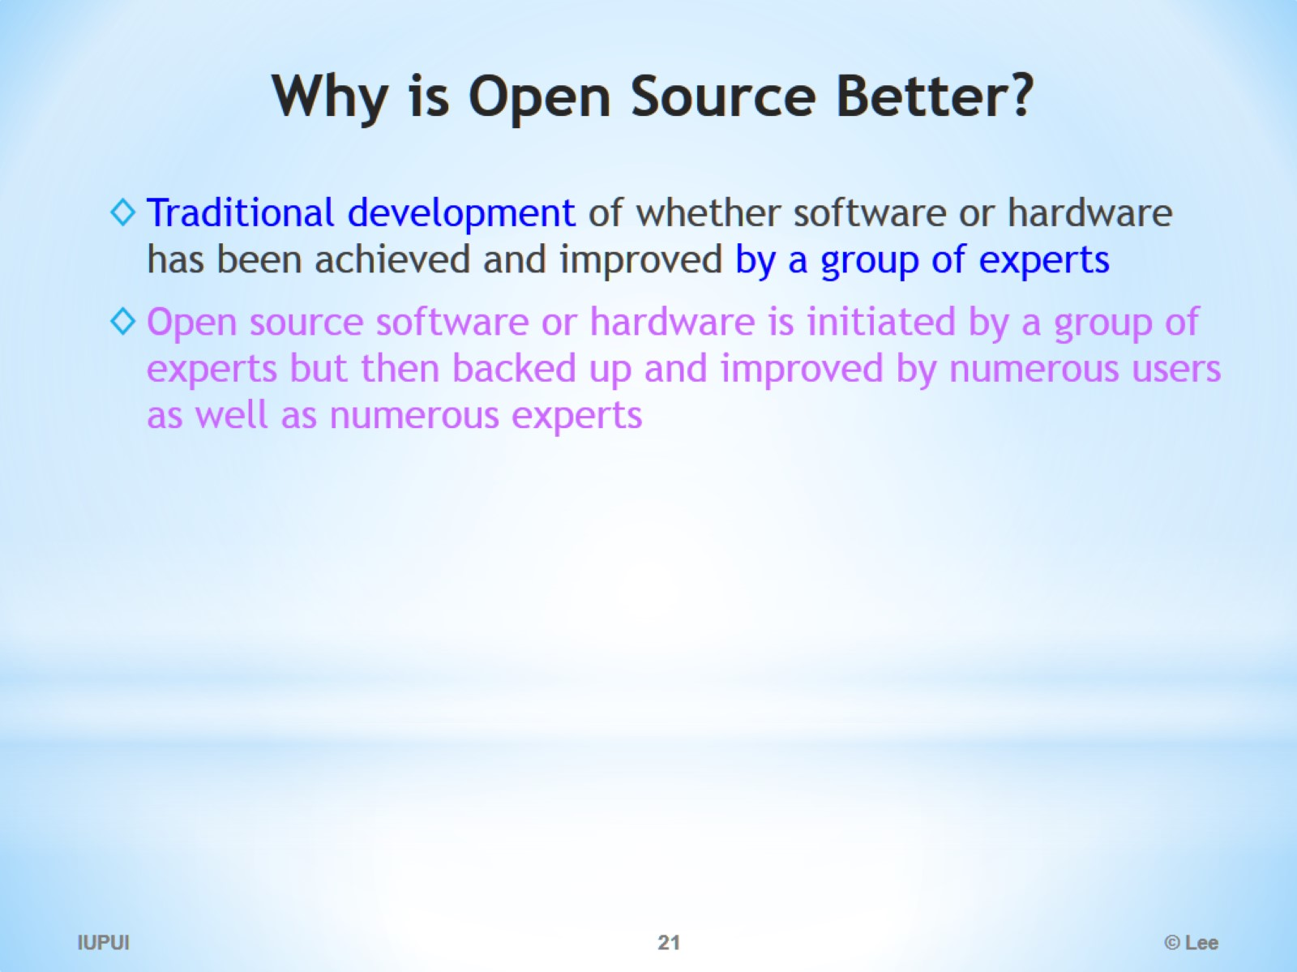
Why is Open Source Better?

Slide 22
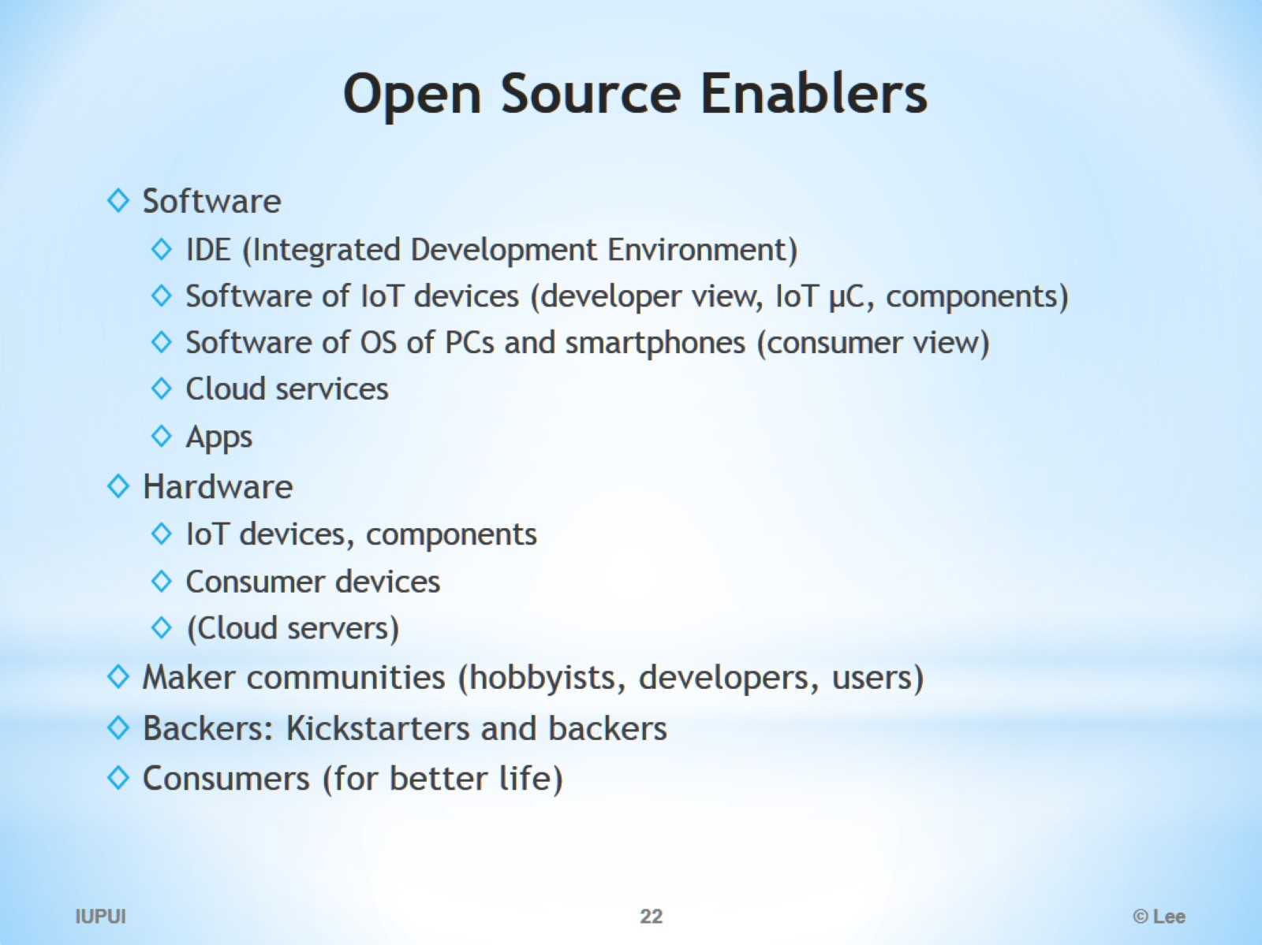
Open Source Enablers

Slide 23

Every Korean’s Messaging App: KakaoTalk/oss_notice.html

Slide 24
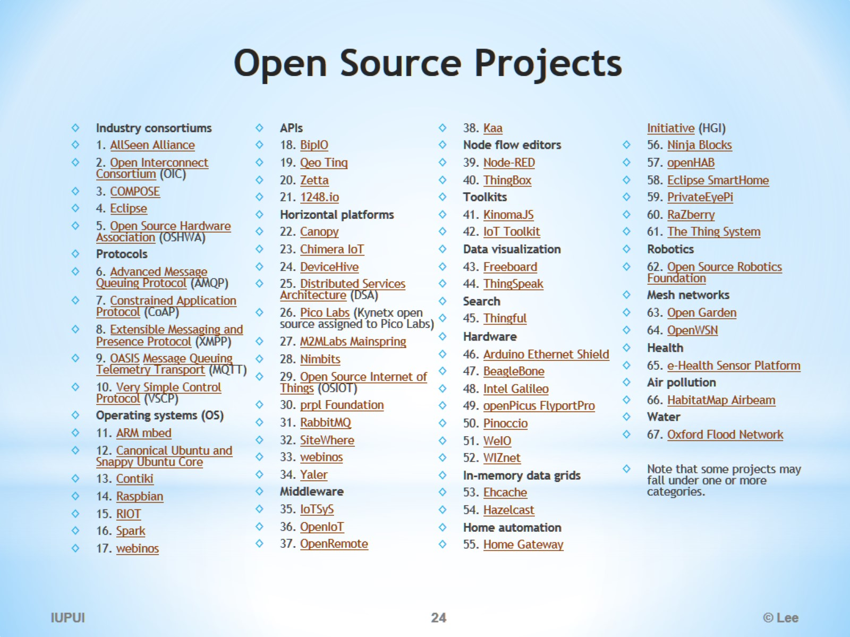
Open Source Projects

Slide 25
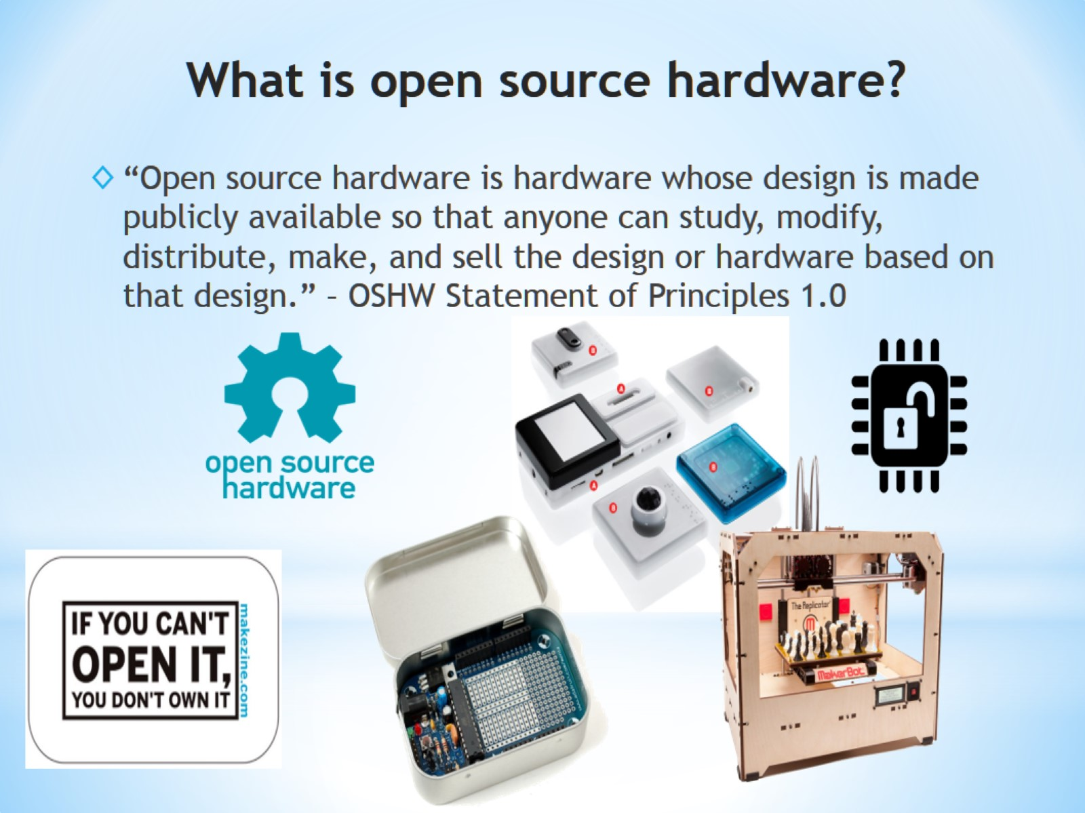
What is open source hardware?

Slide 26
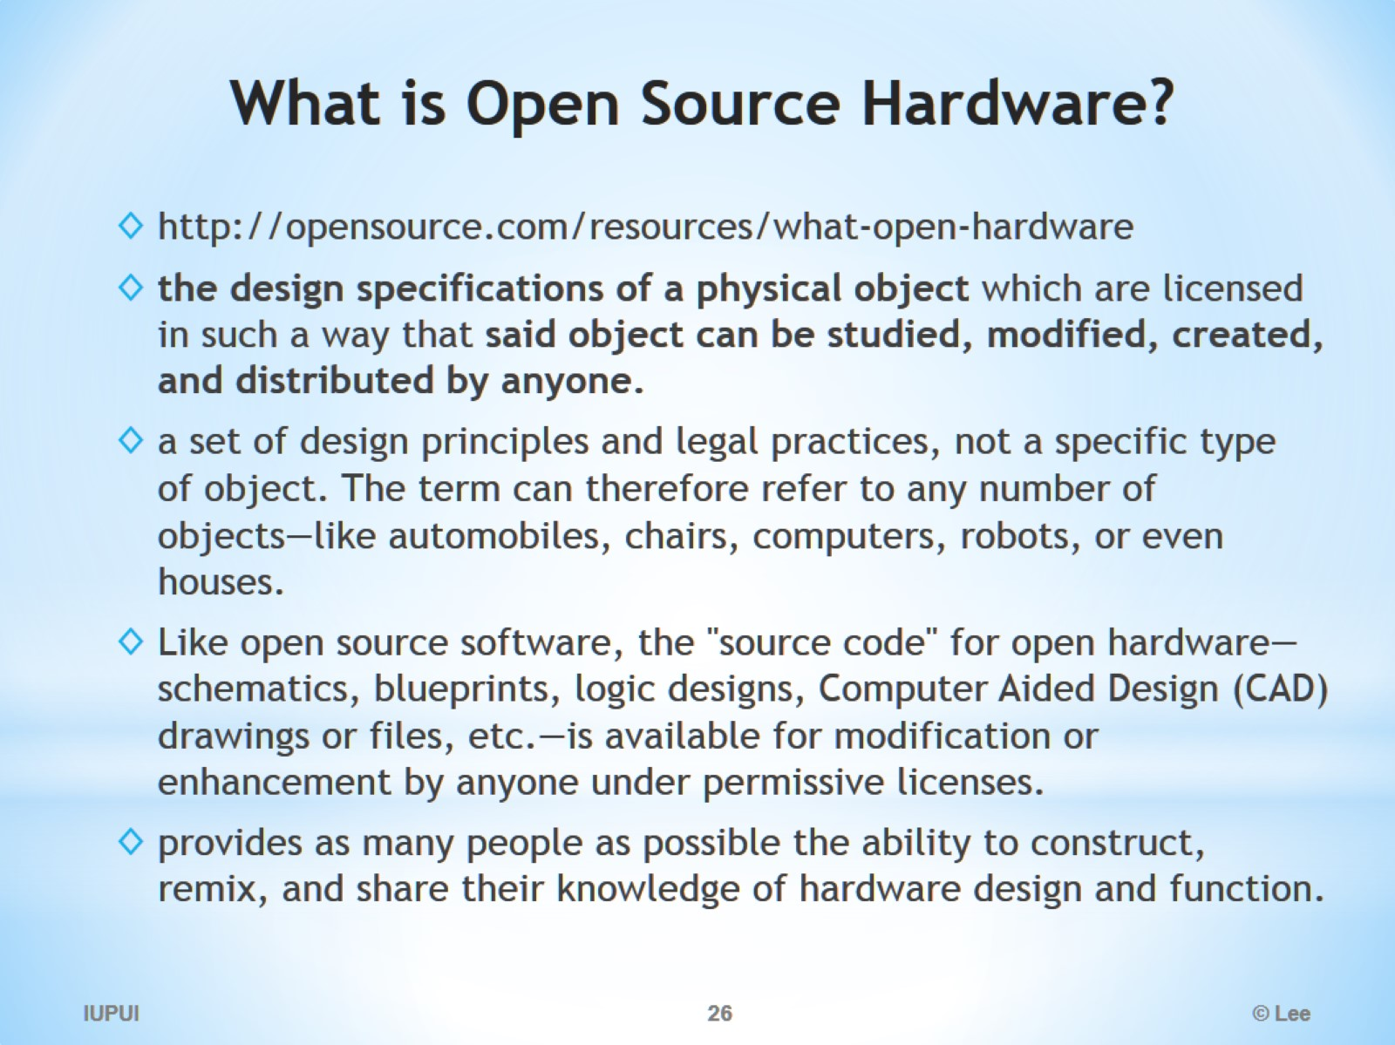
What is Open Source Hardware?

Slide 27
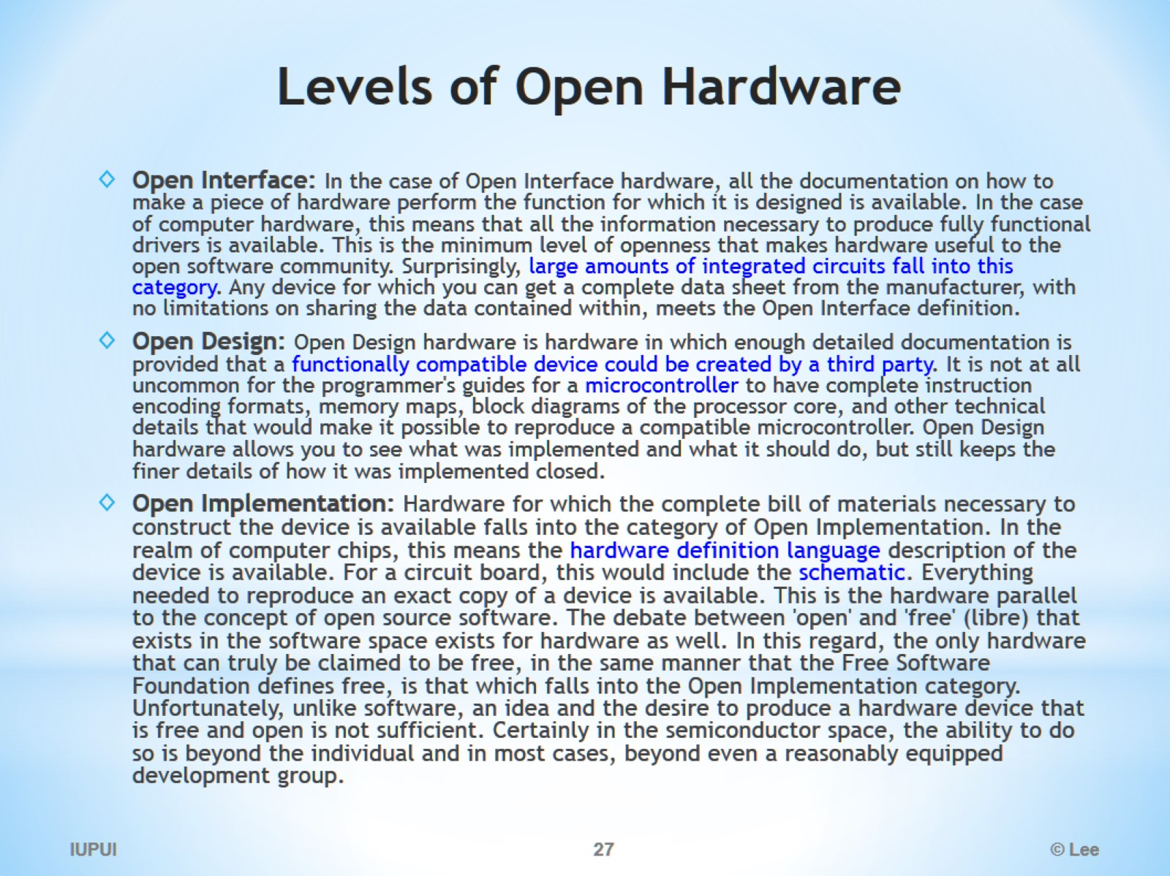
Levels of Open Hardware

Slide 28
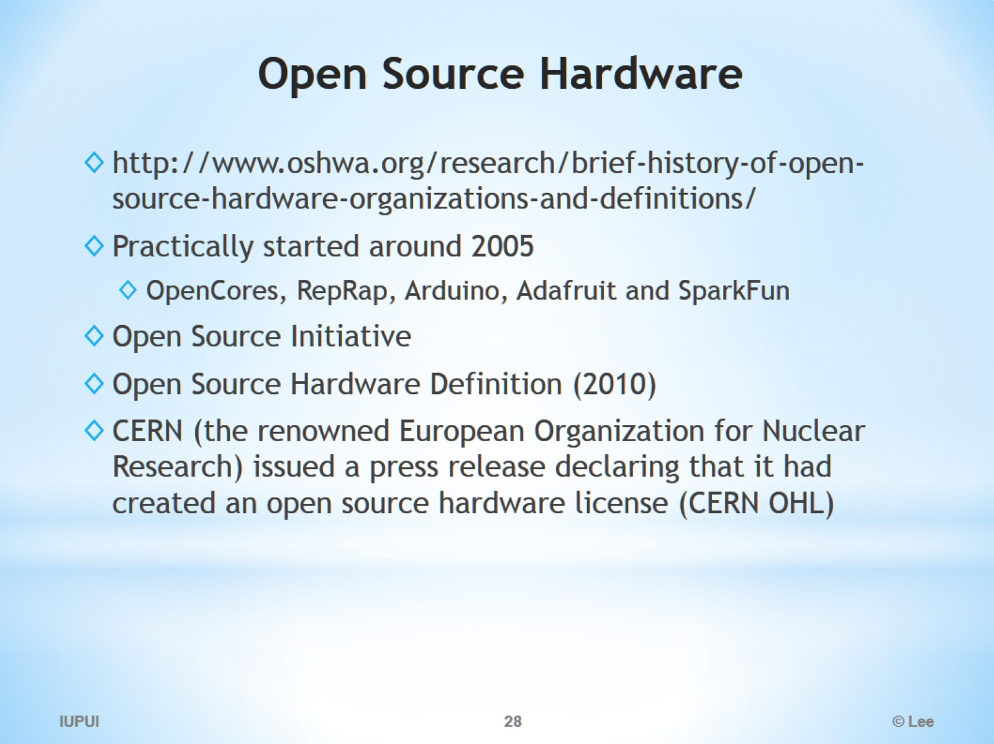
Open Source Hardware

Slide 29
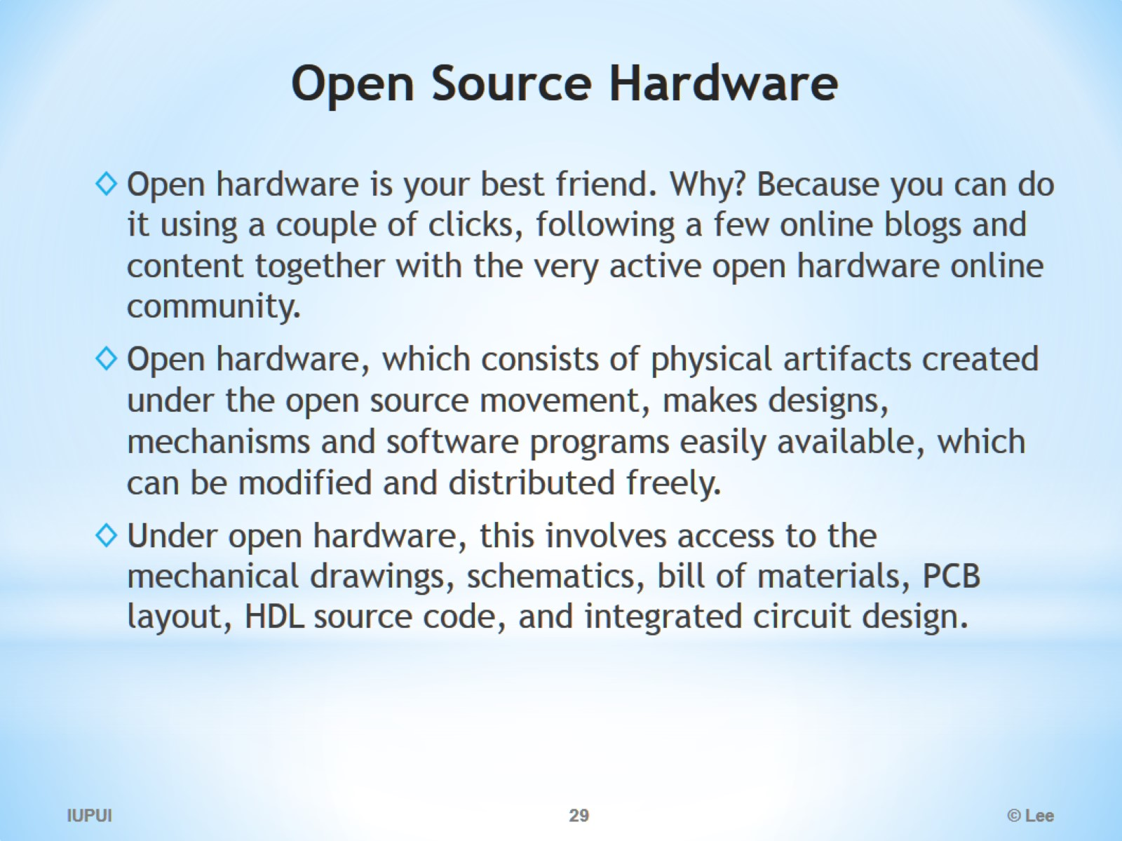
Open Source Hardware

Slide 30
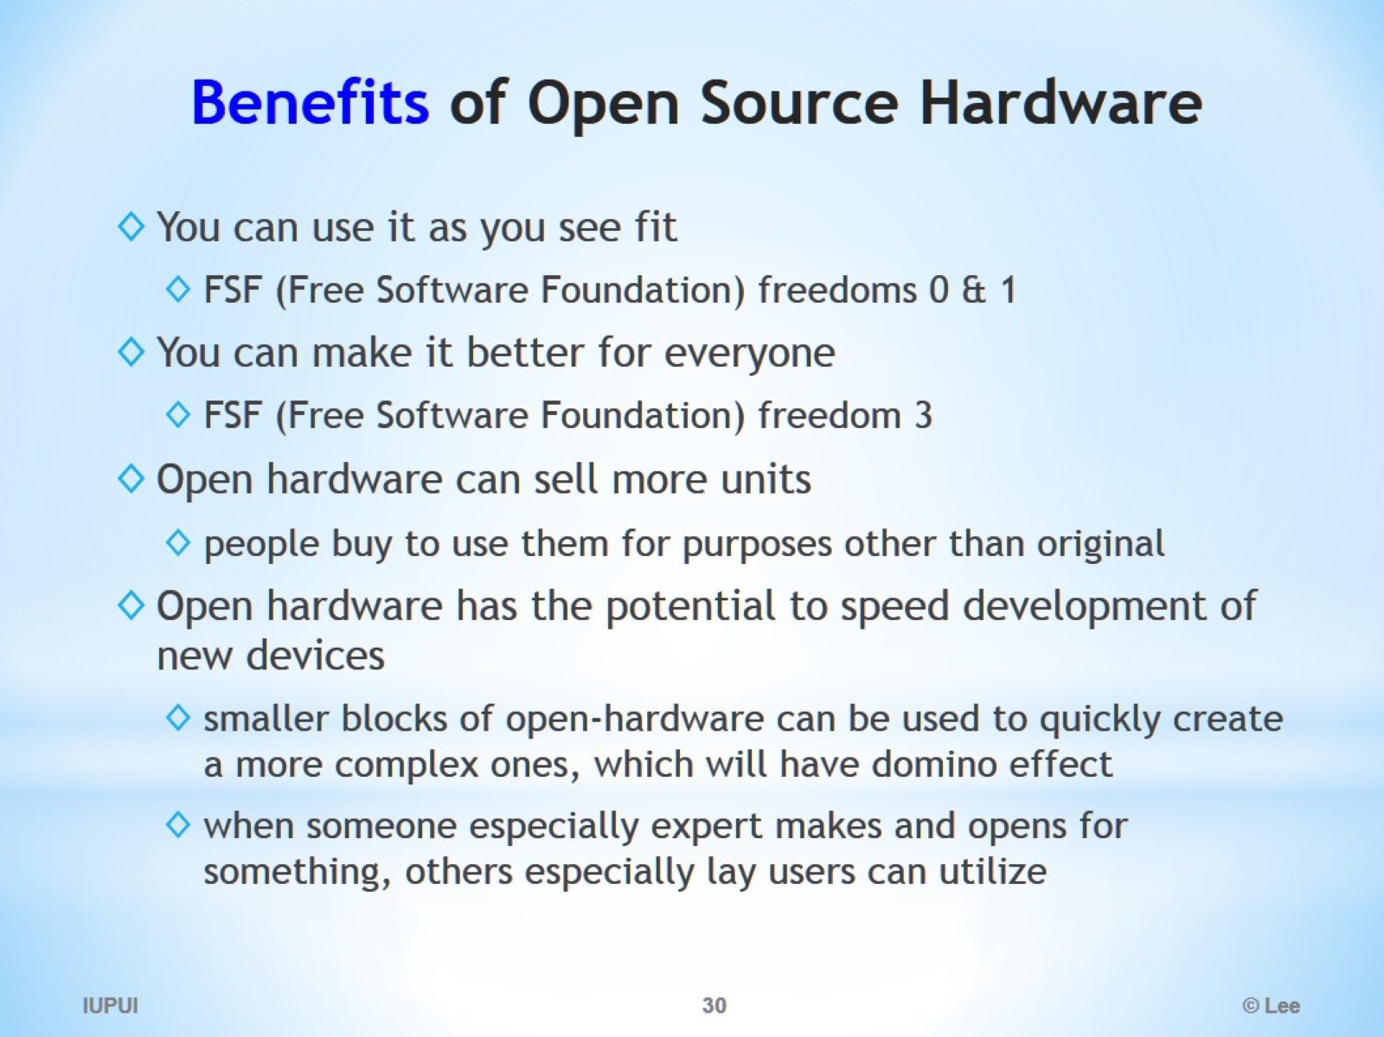
Benefits of Open Source Hardware

Slide 31
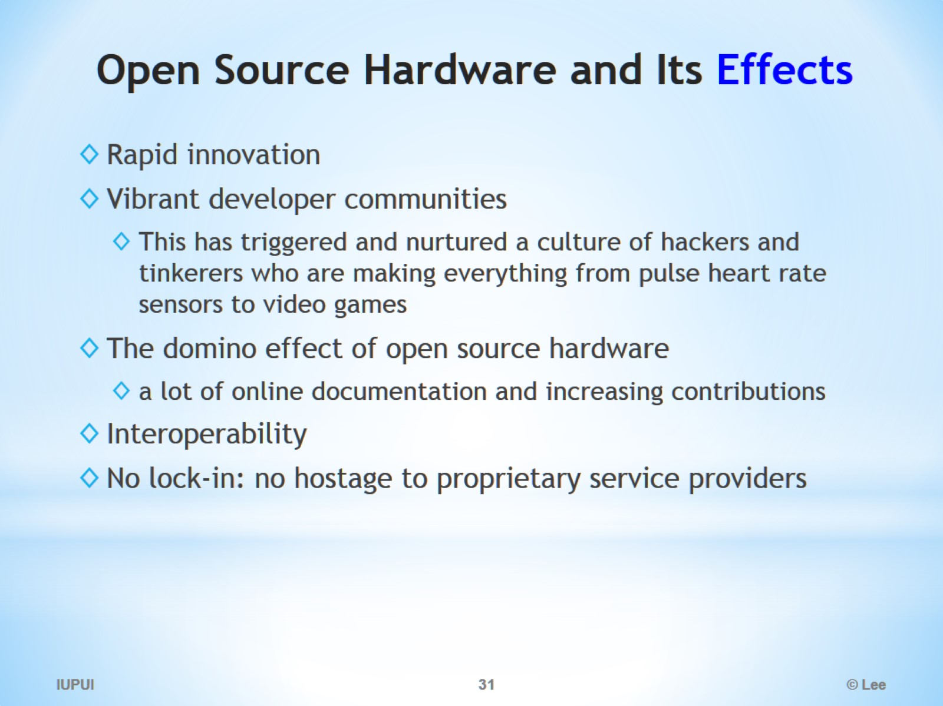
Open Source Hardware and Its Effects

Slide 32
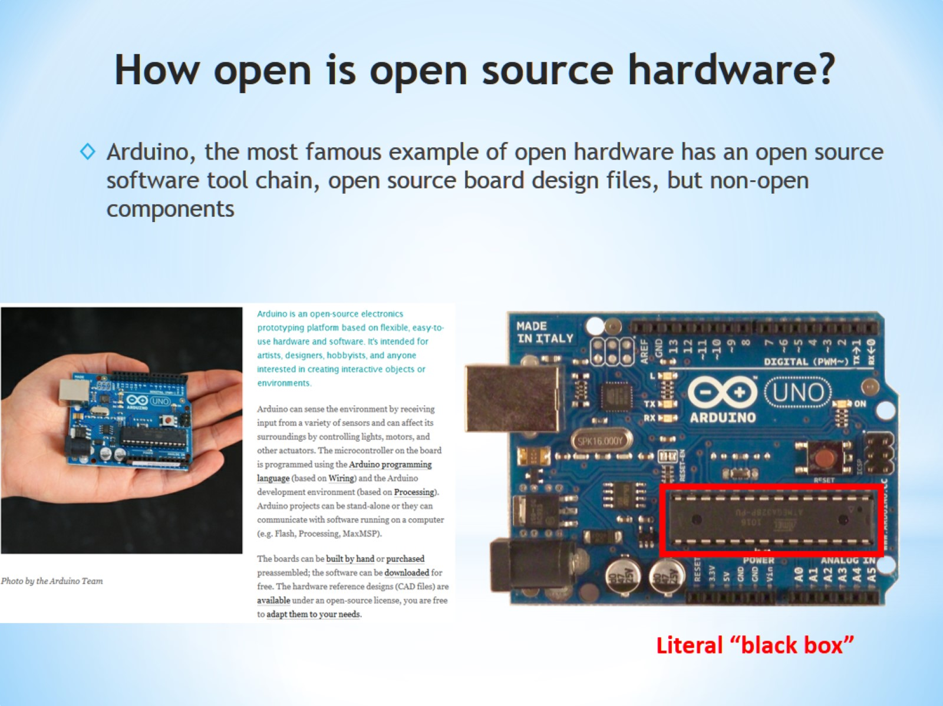
How open is open source hardware?

Slide 33
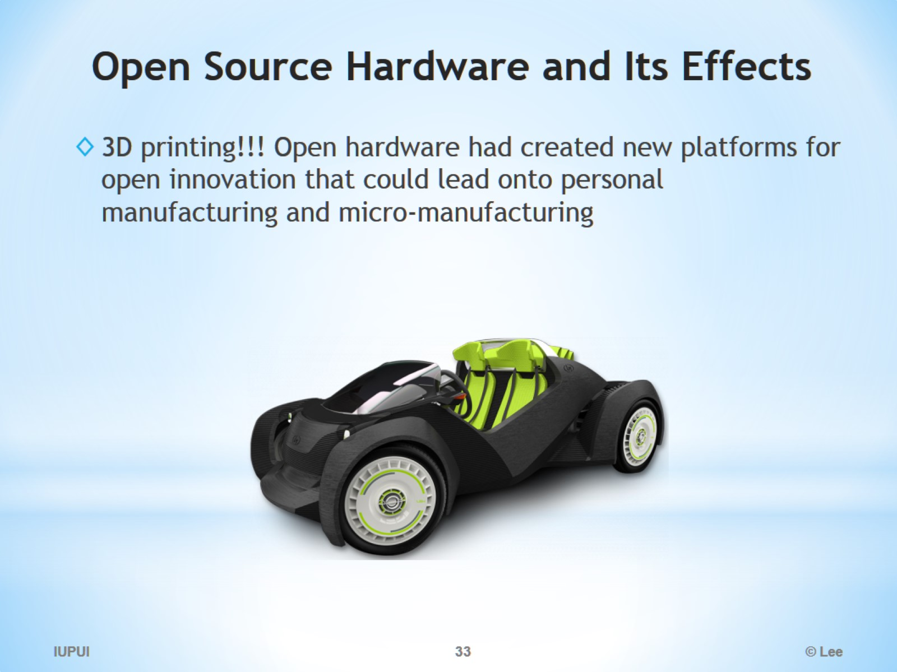
Open Source Hardware and Its Effects

Slide 34
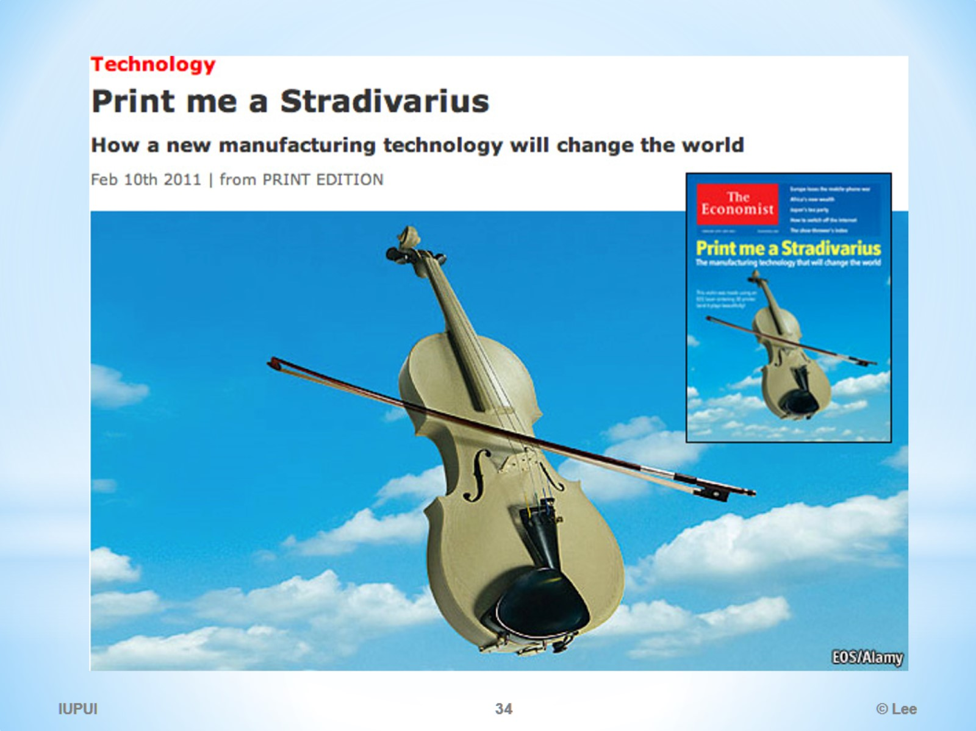

Slide 35
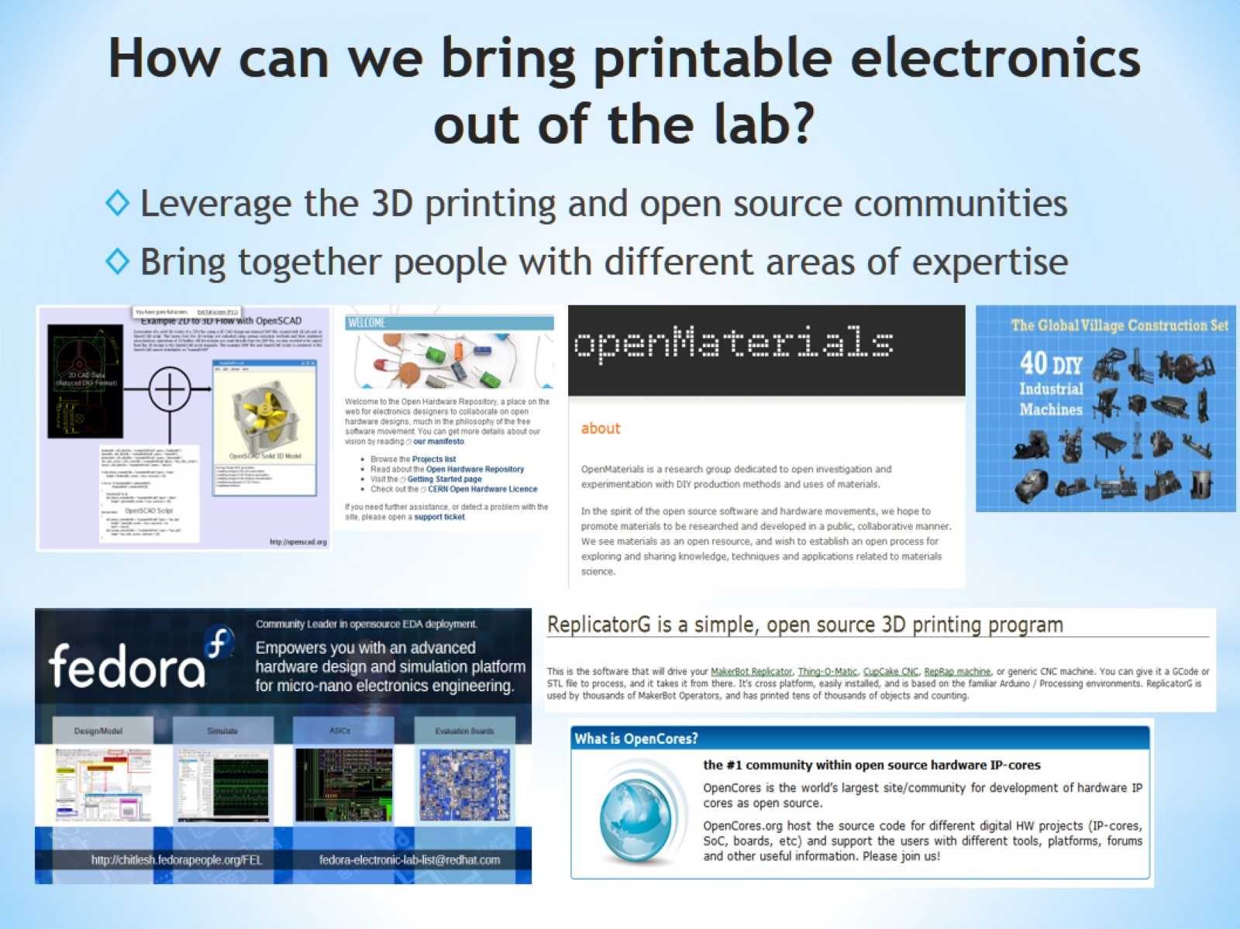
How can we bring printable electronics out of the lab?

Slide 36
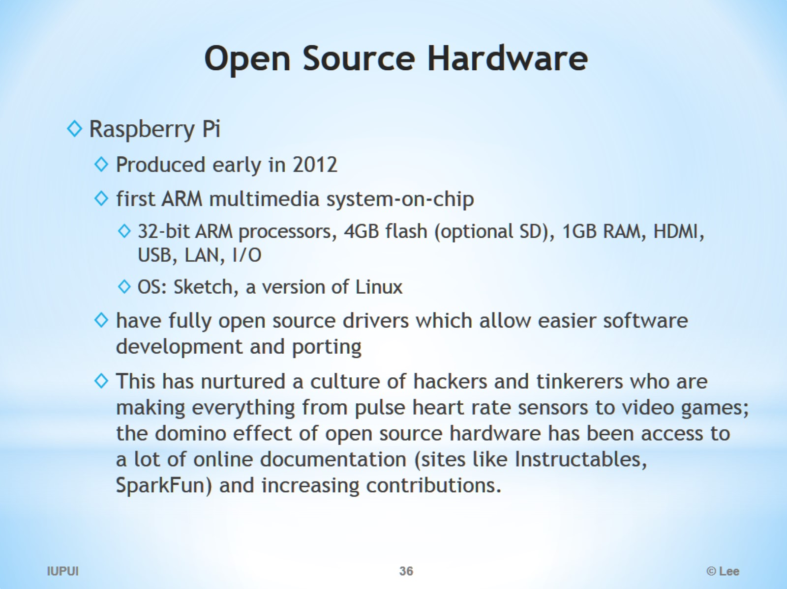
Open Source Hardware

Slide 37
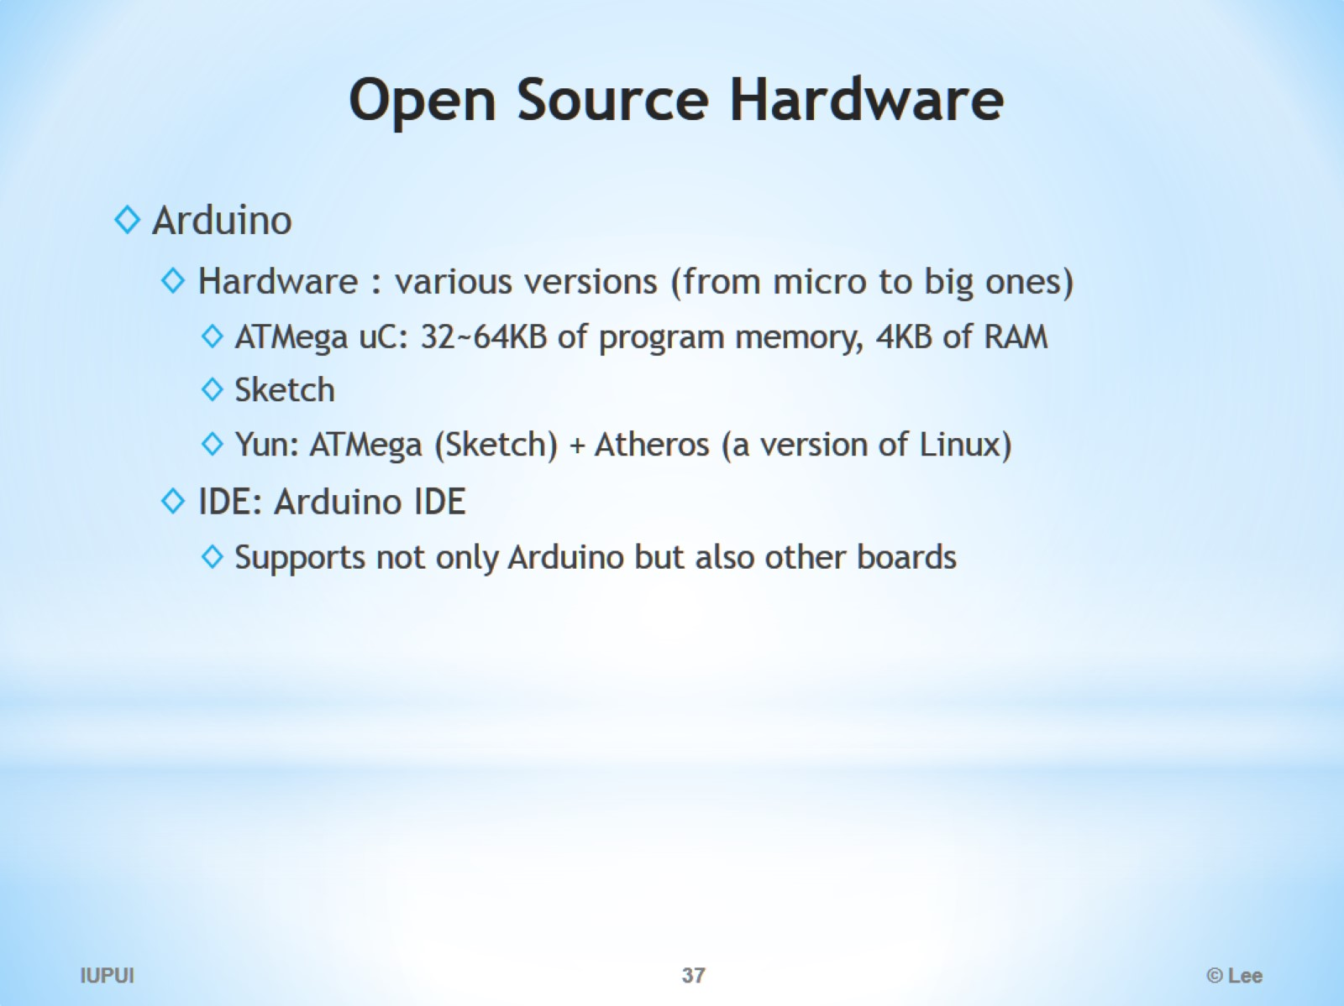
Open Source Hardware

Slide 38
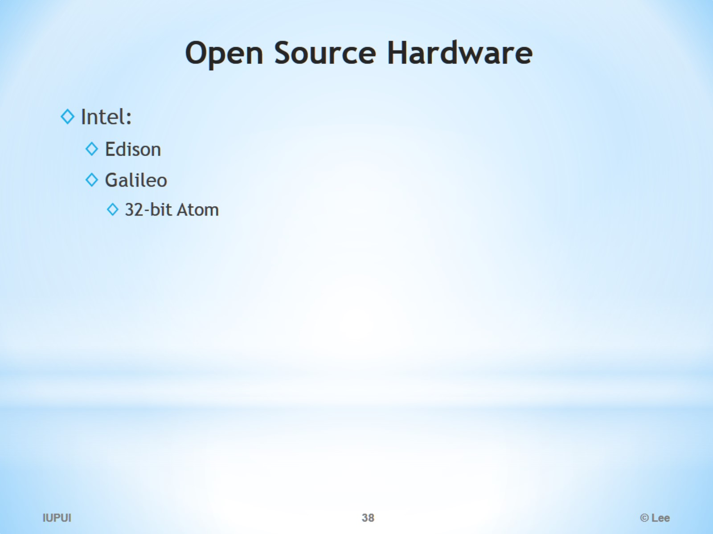
Open Source Hardware

Slide 39
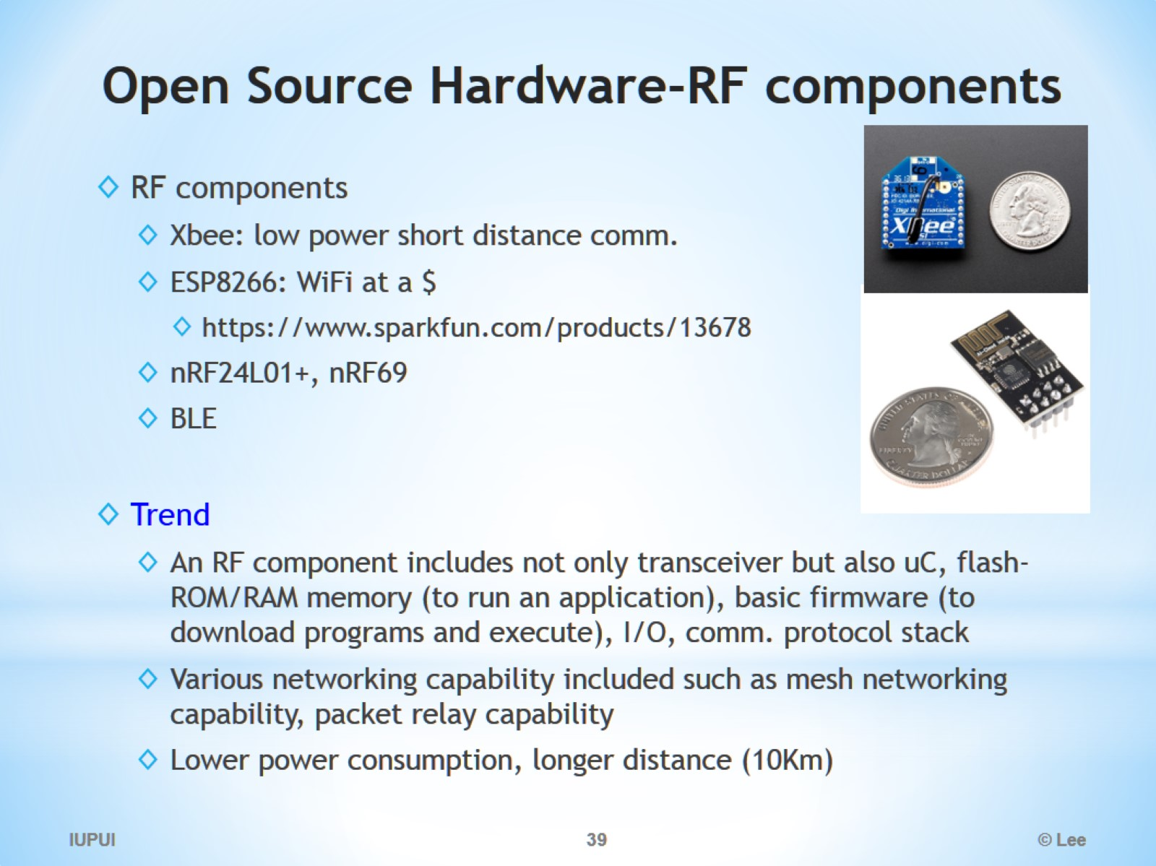
Open Source Hardware-RF components

Slide 40
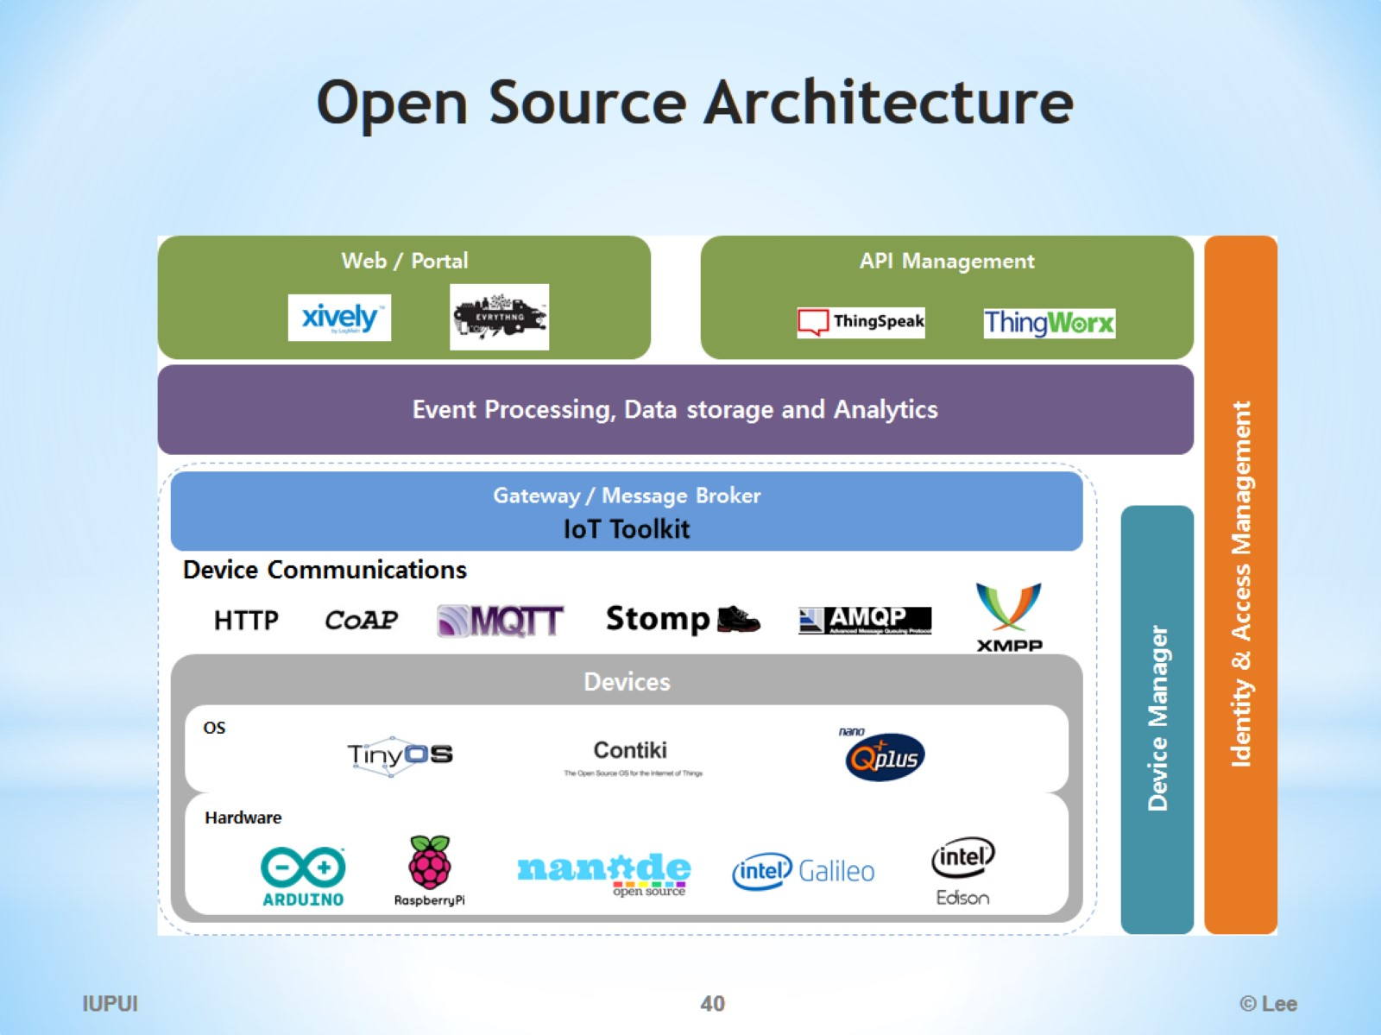
Open Source Architecture

Slide 41
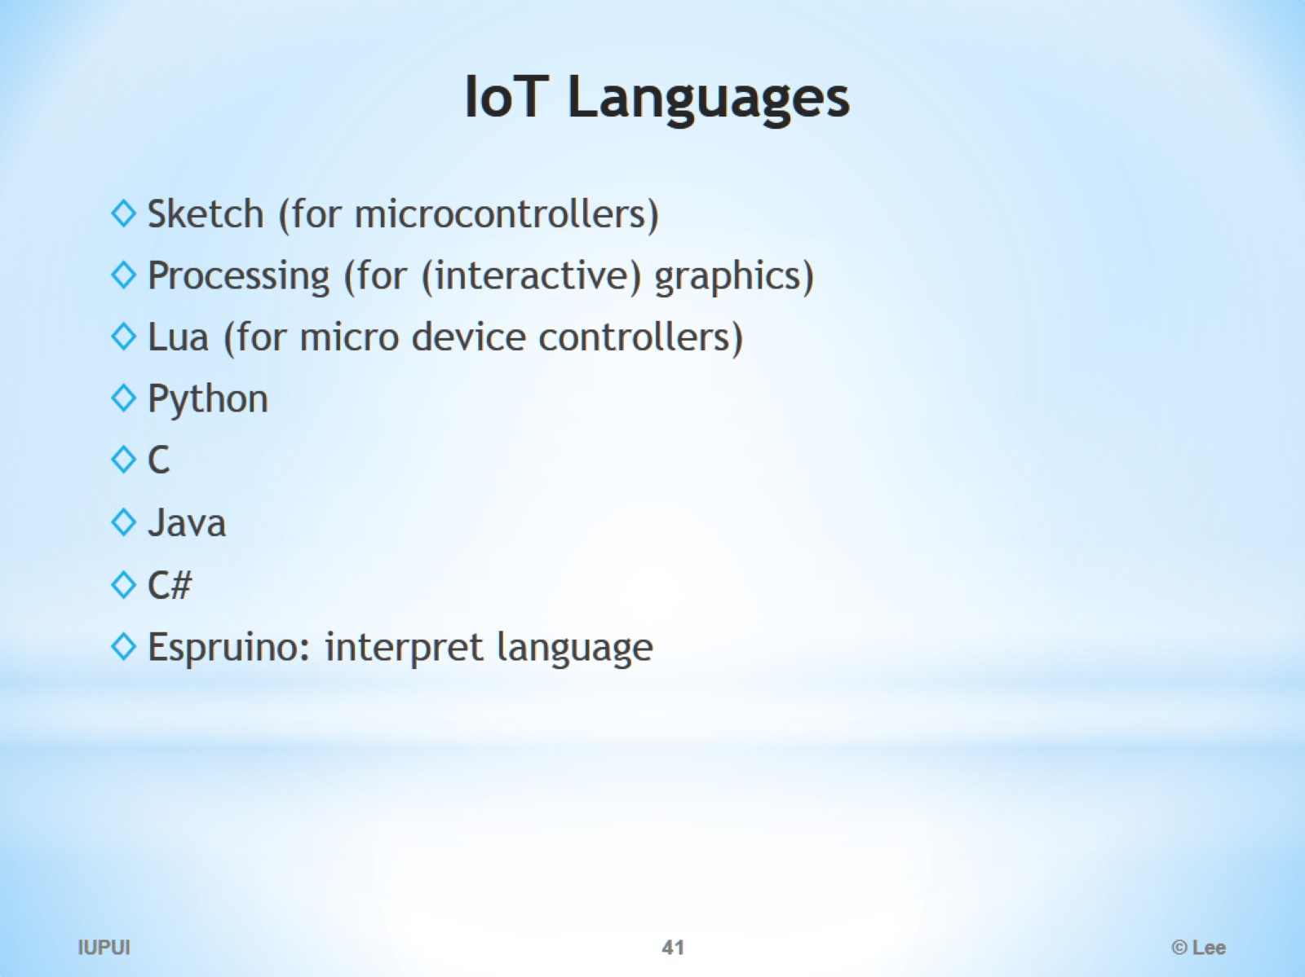
IoT Languages

Slide 42
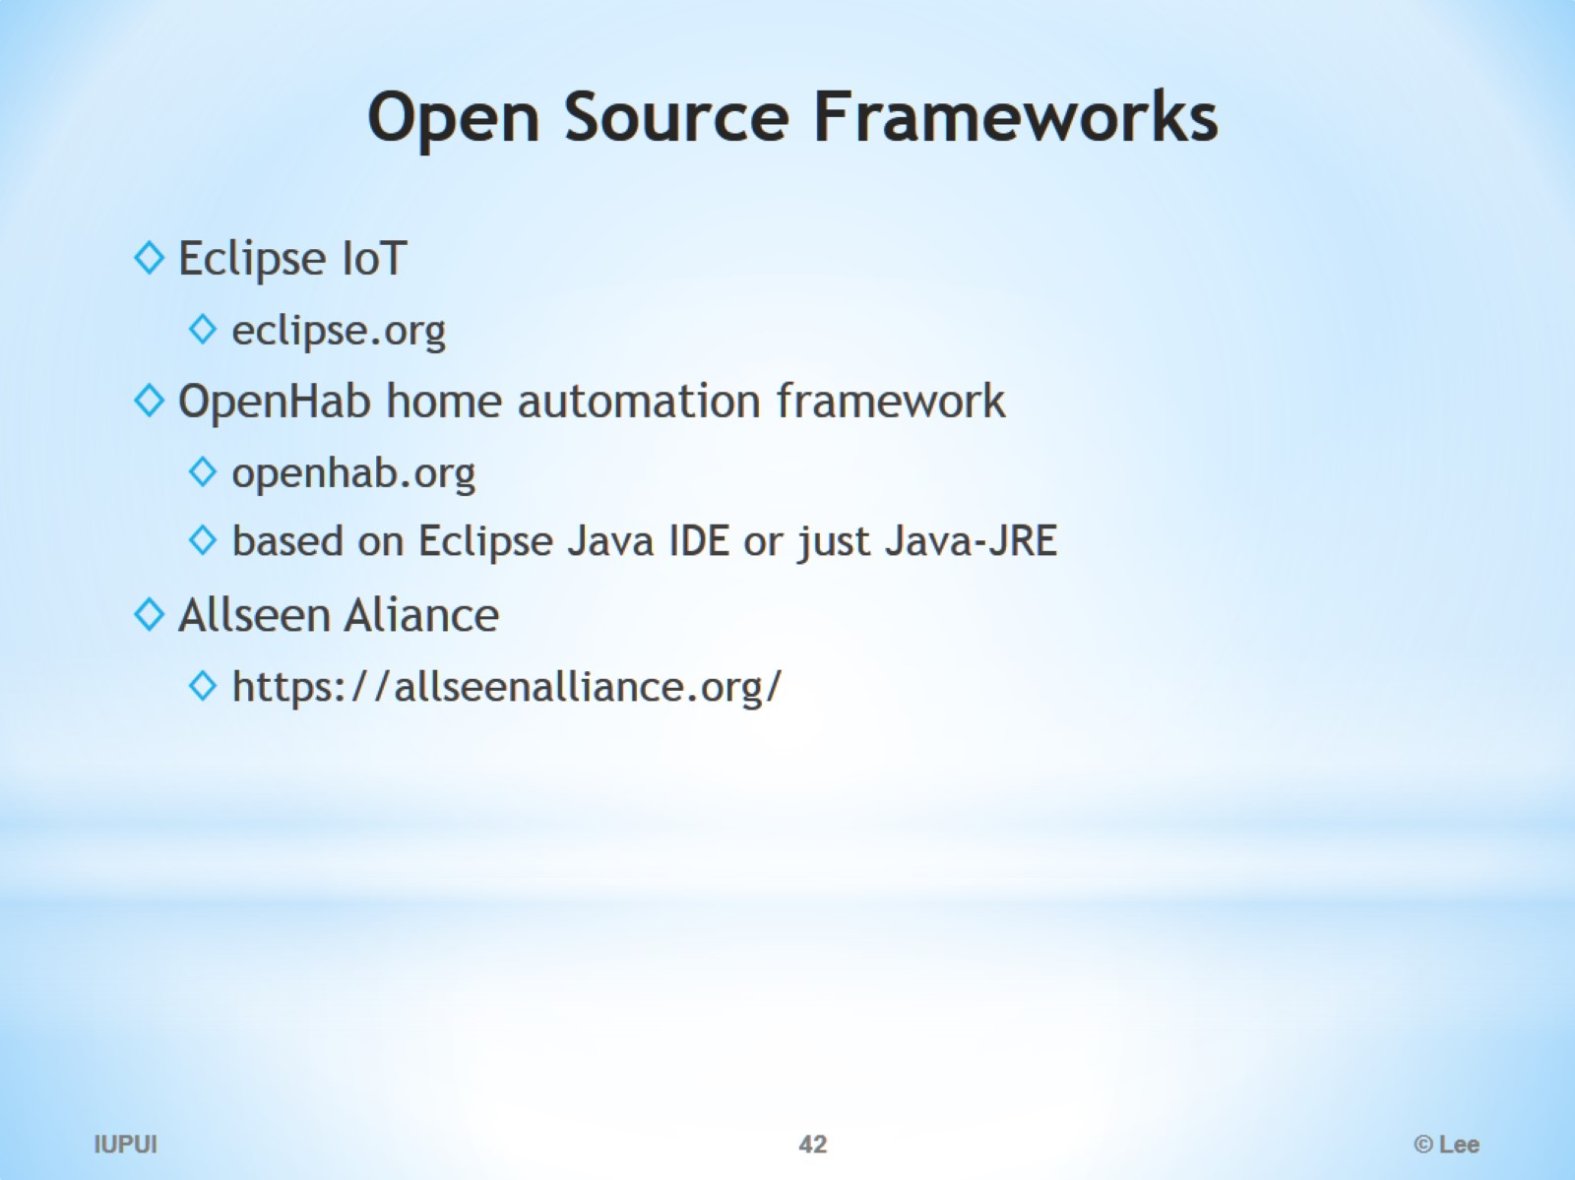
Open Source Frameworks

Slide 43
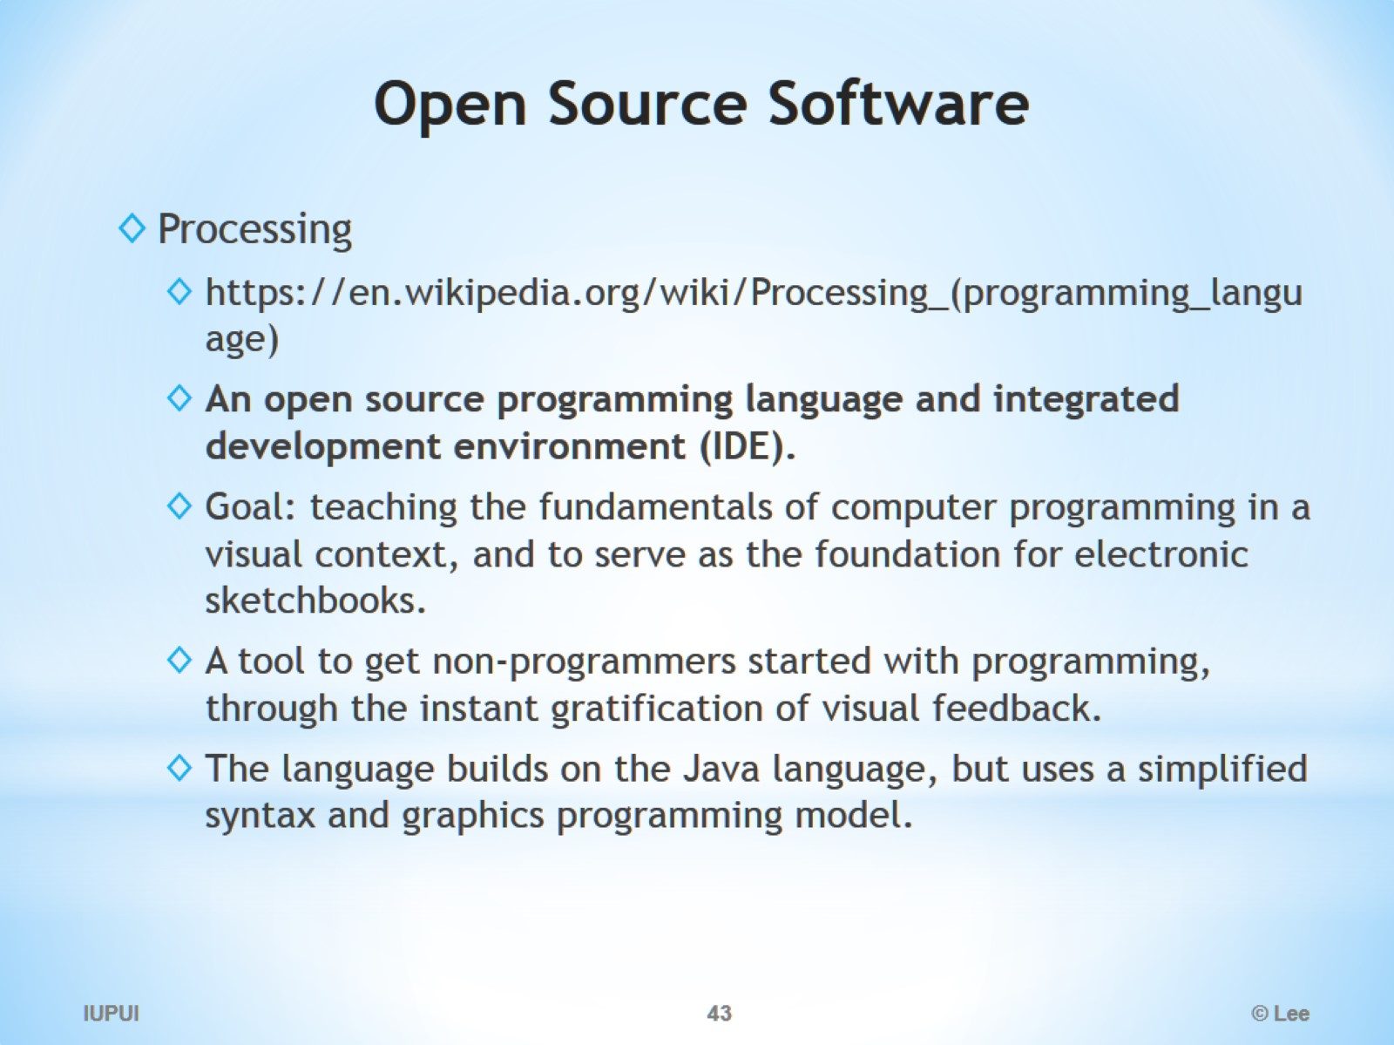
Open Source Software

Slide 44
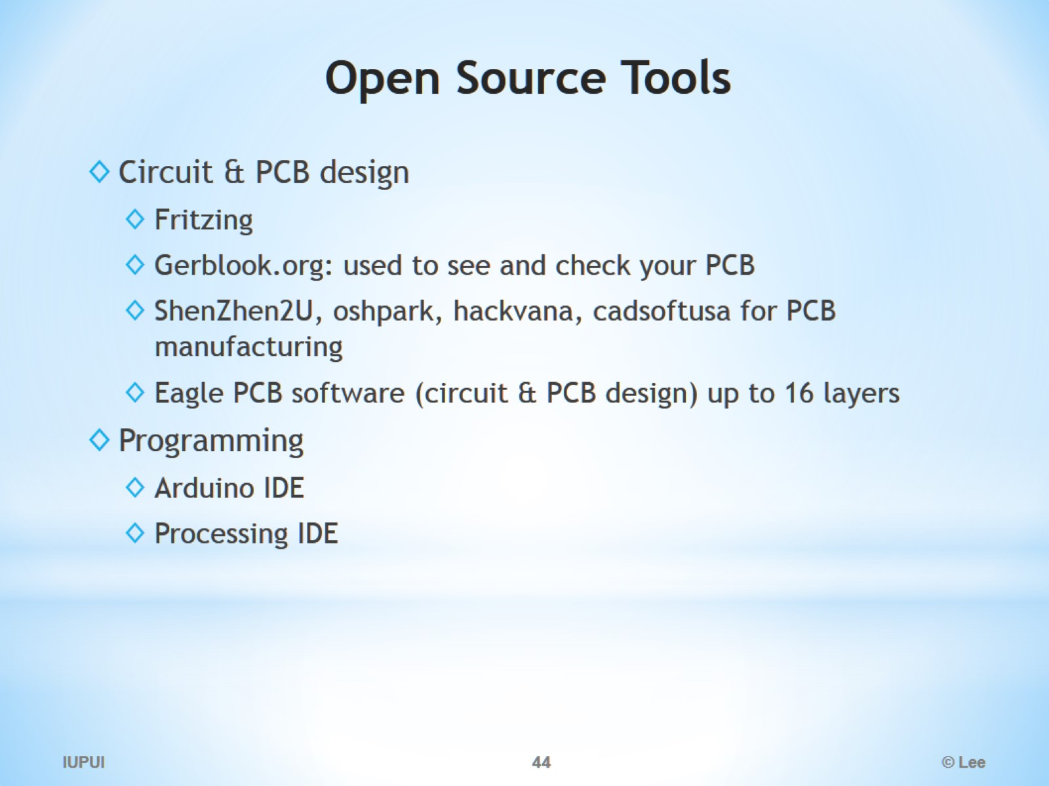
Open Source Tools

Slide 45
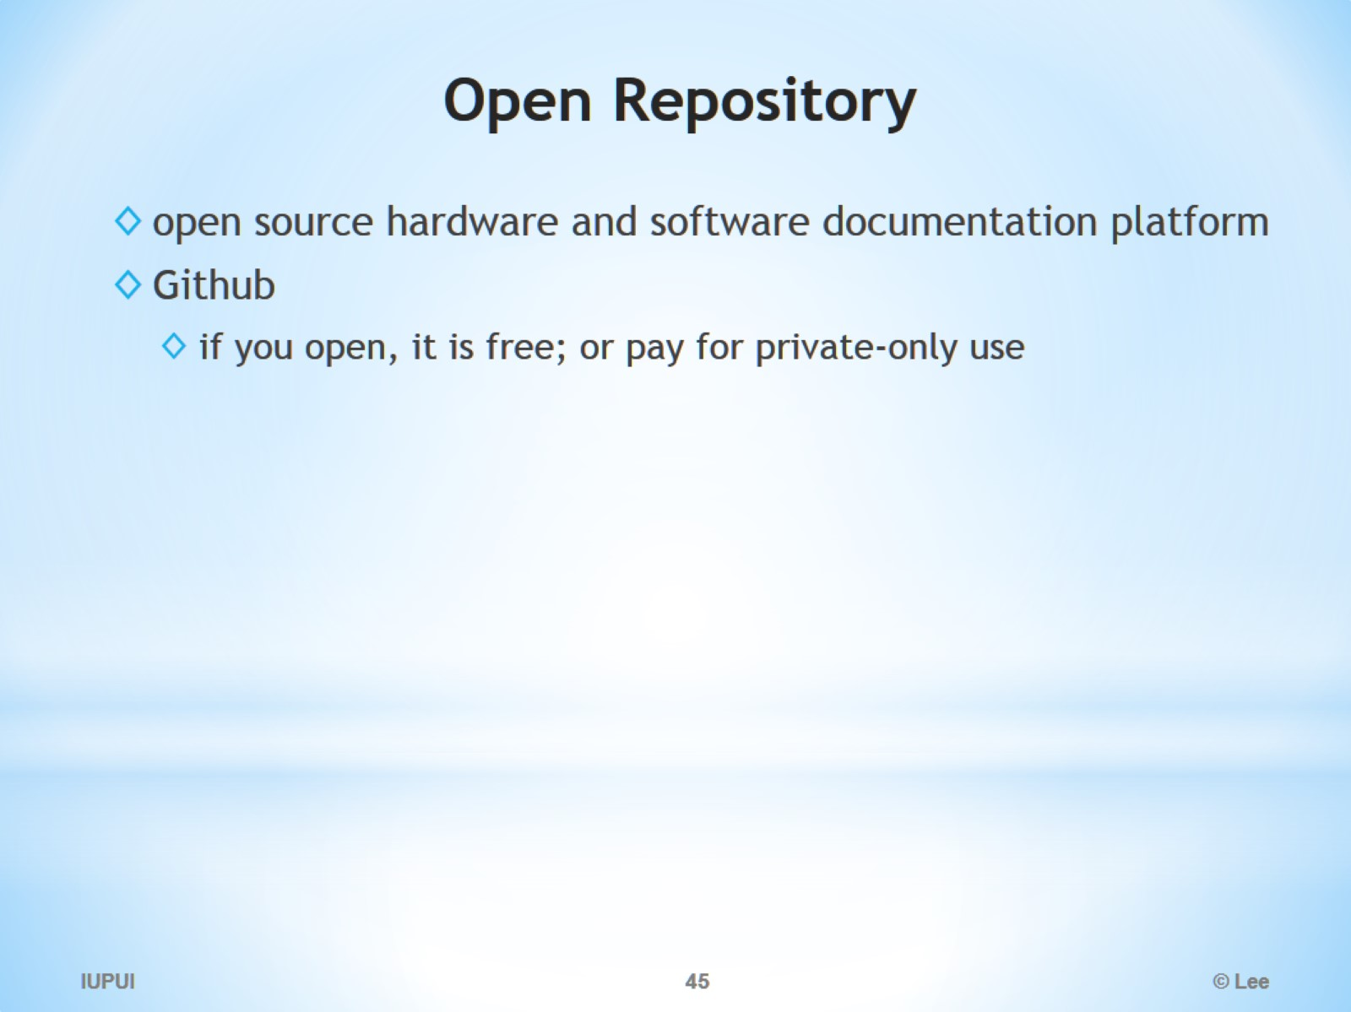
Open Repository

Slide 46
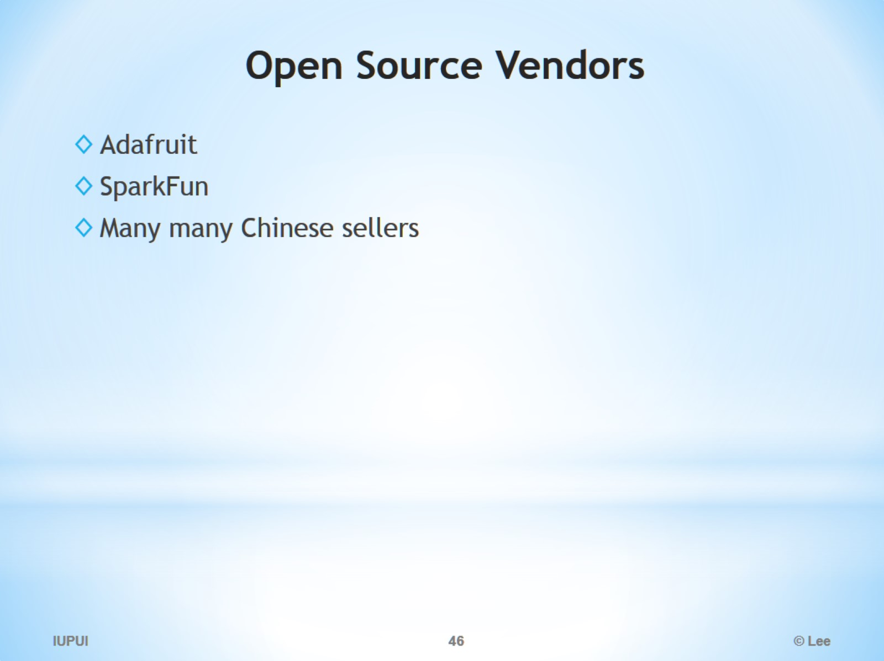
Open Source Vendors

Slide 47
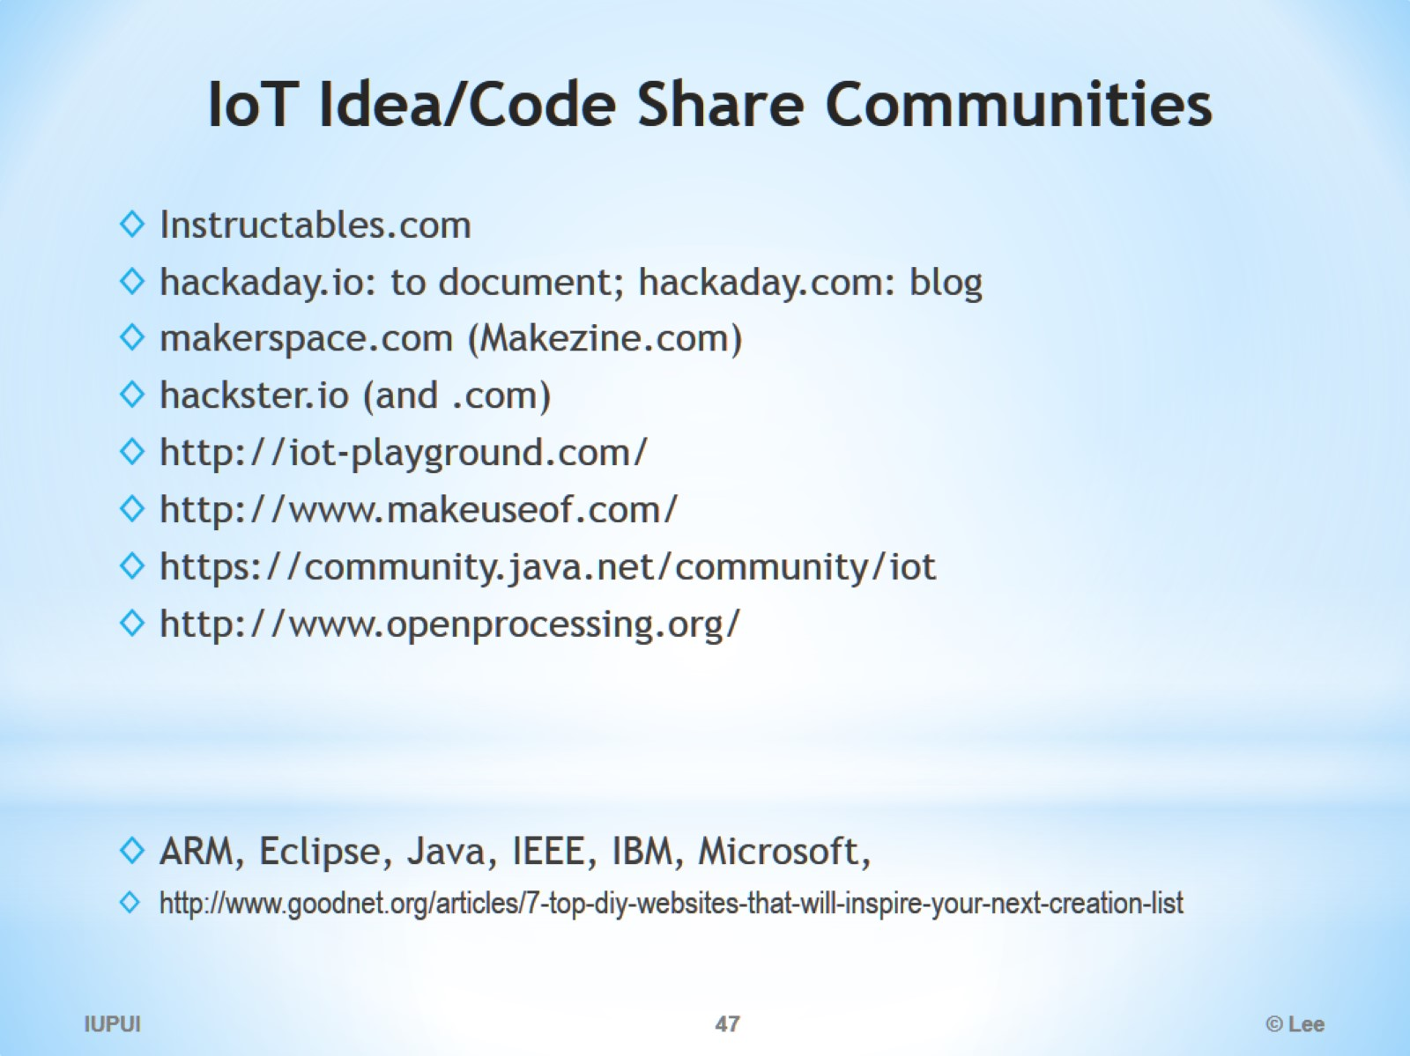
IoT Idea/Code Share Communities

Slide 48
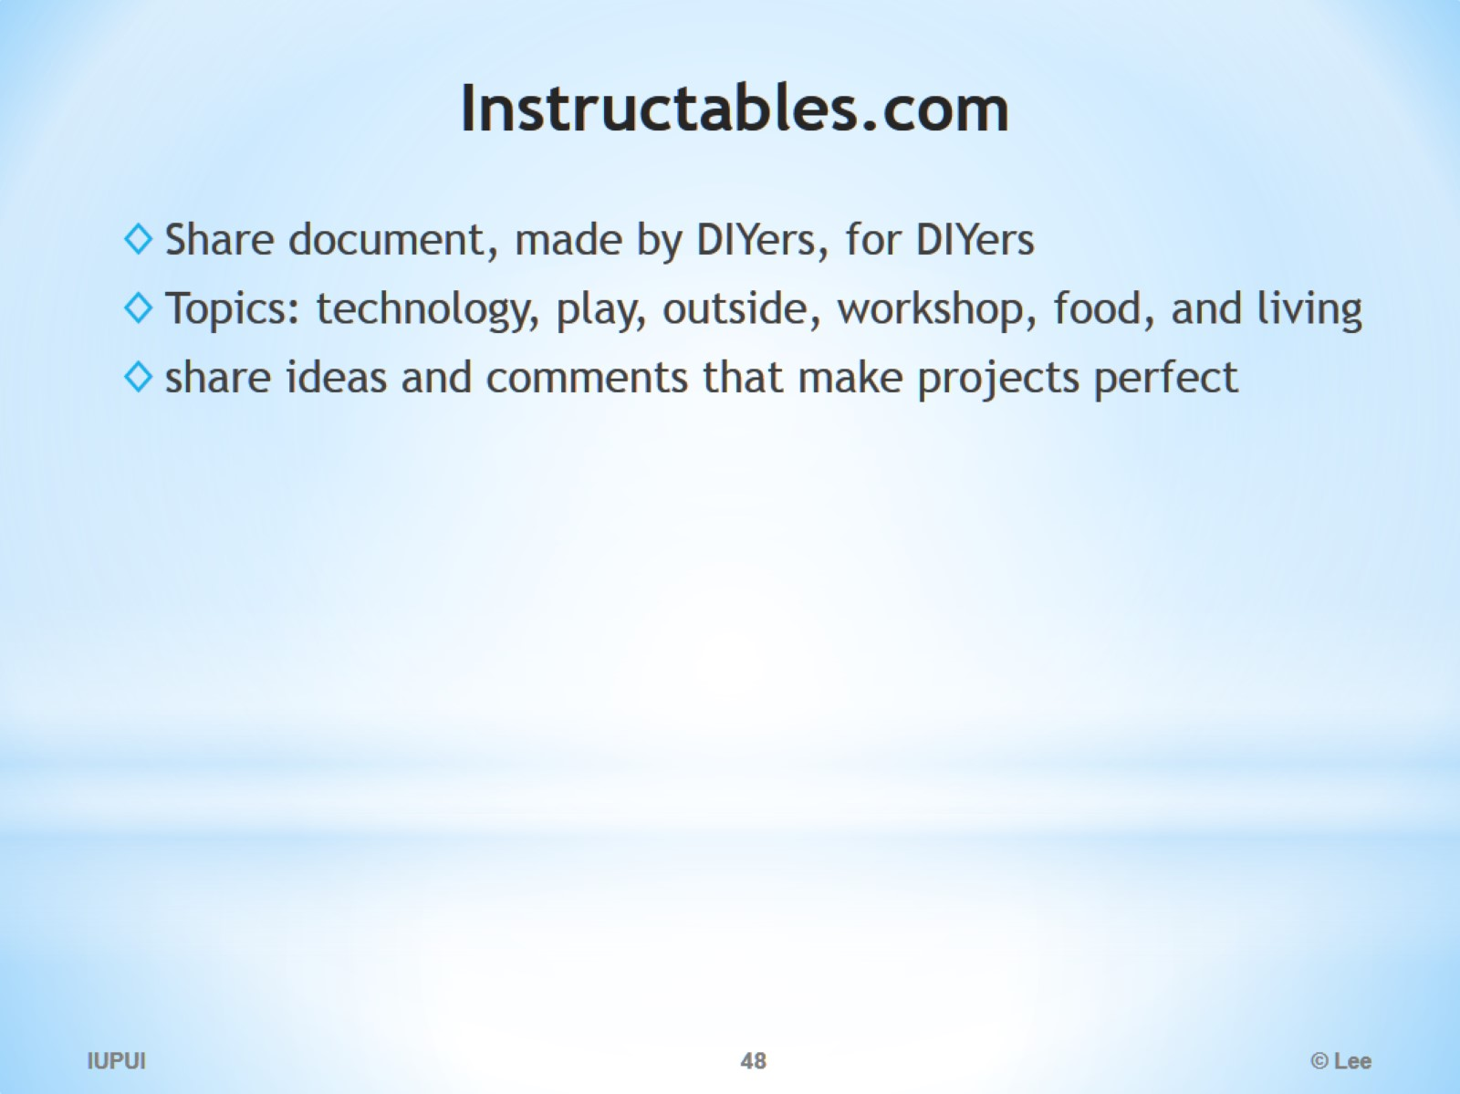
Instructables.com

Slide 49
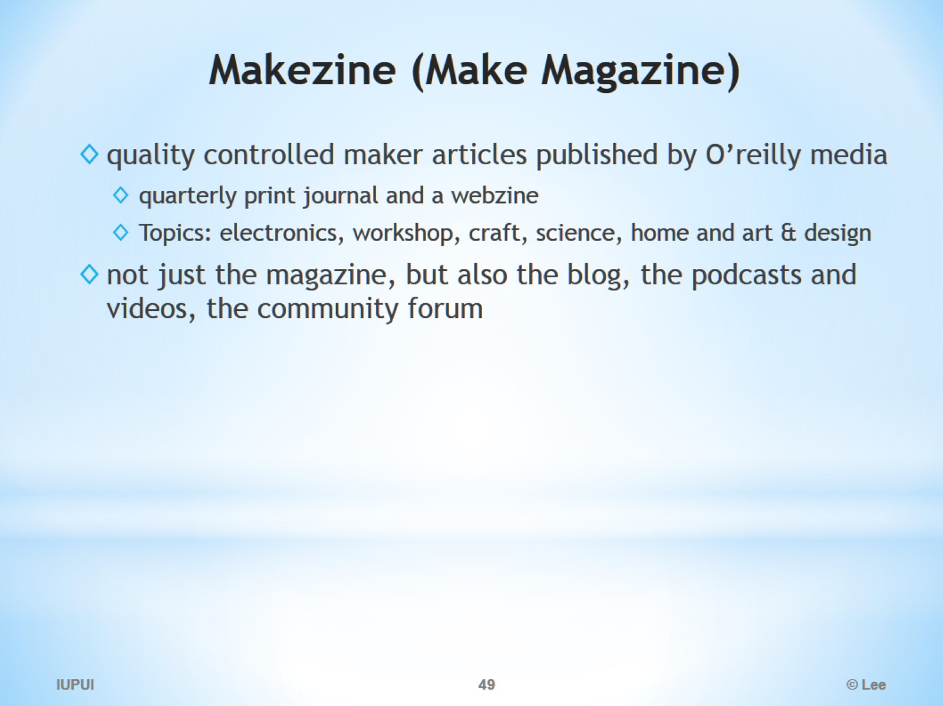
Makezine (Make Magazine)

Slide 50
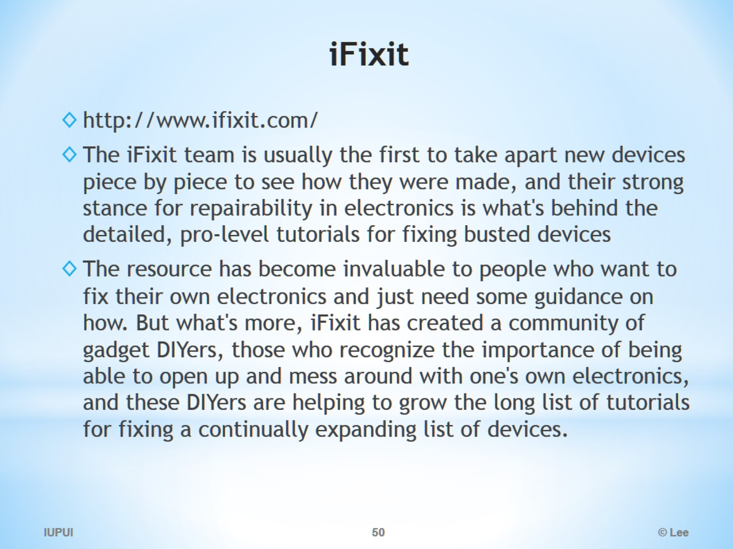
iFixit

Slide 51
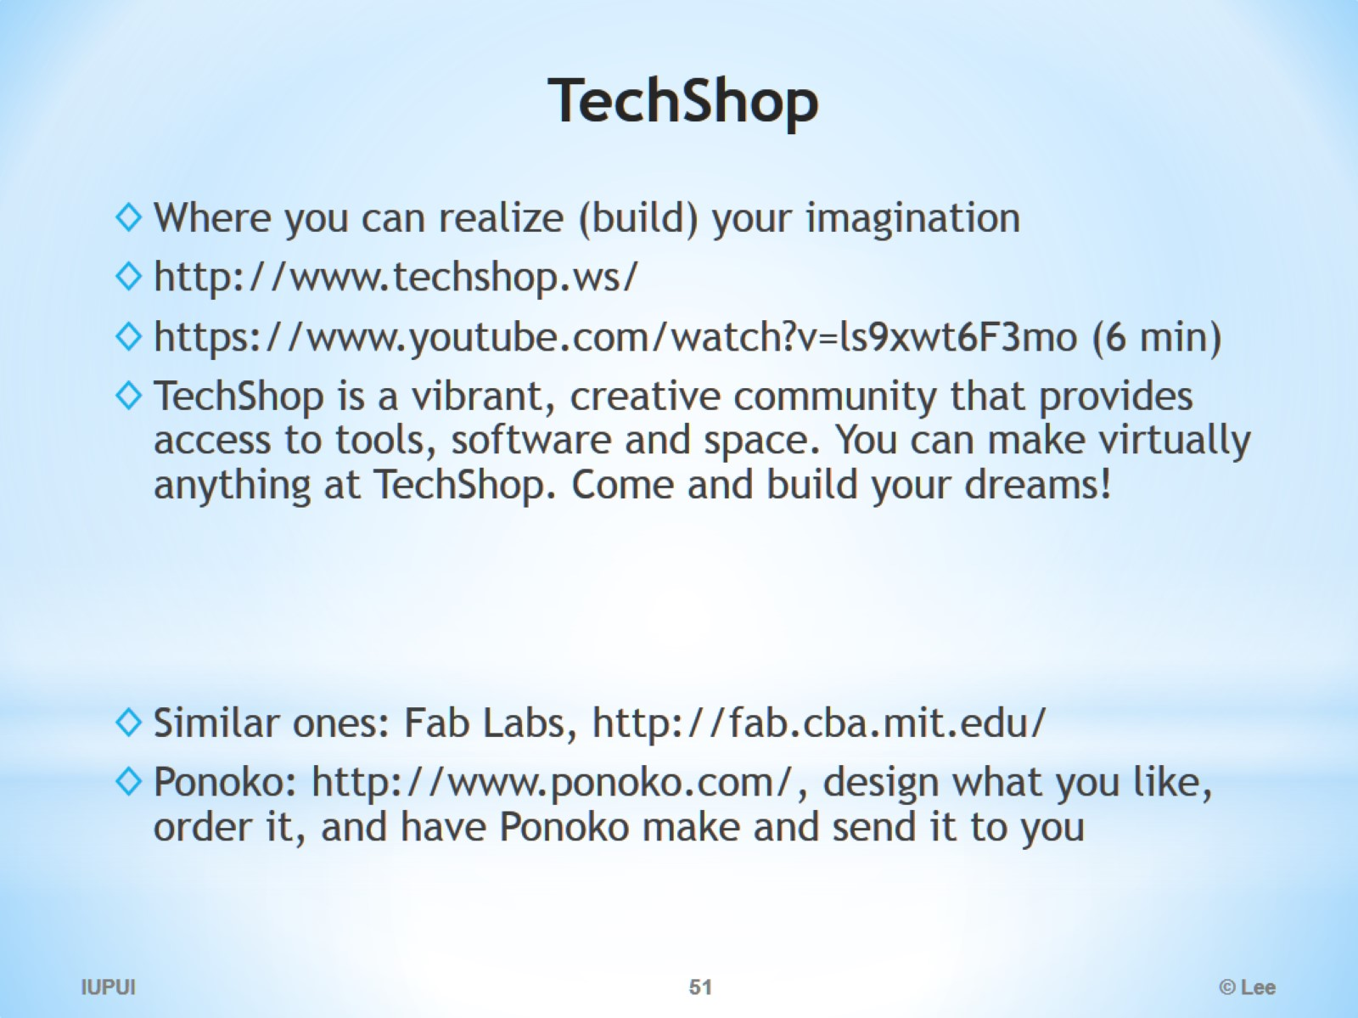
TechShop

Slide 52
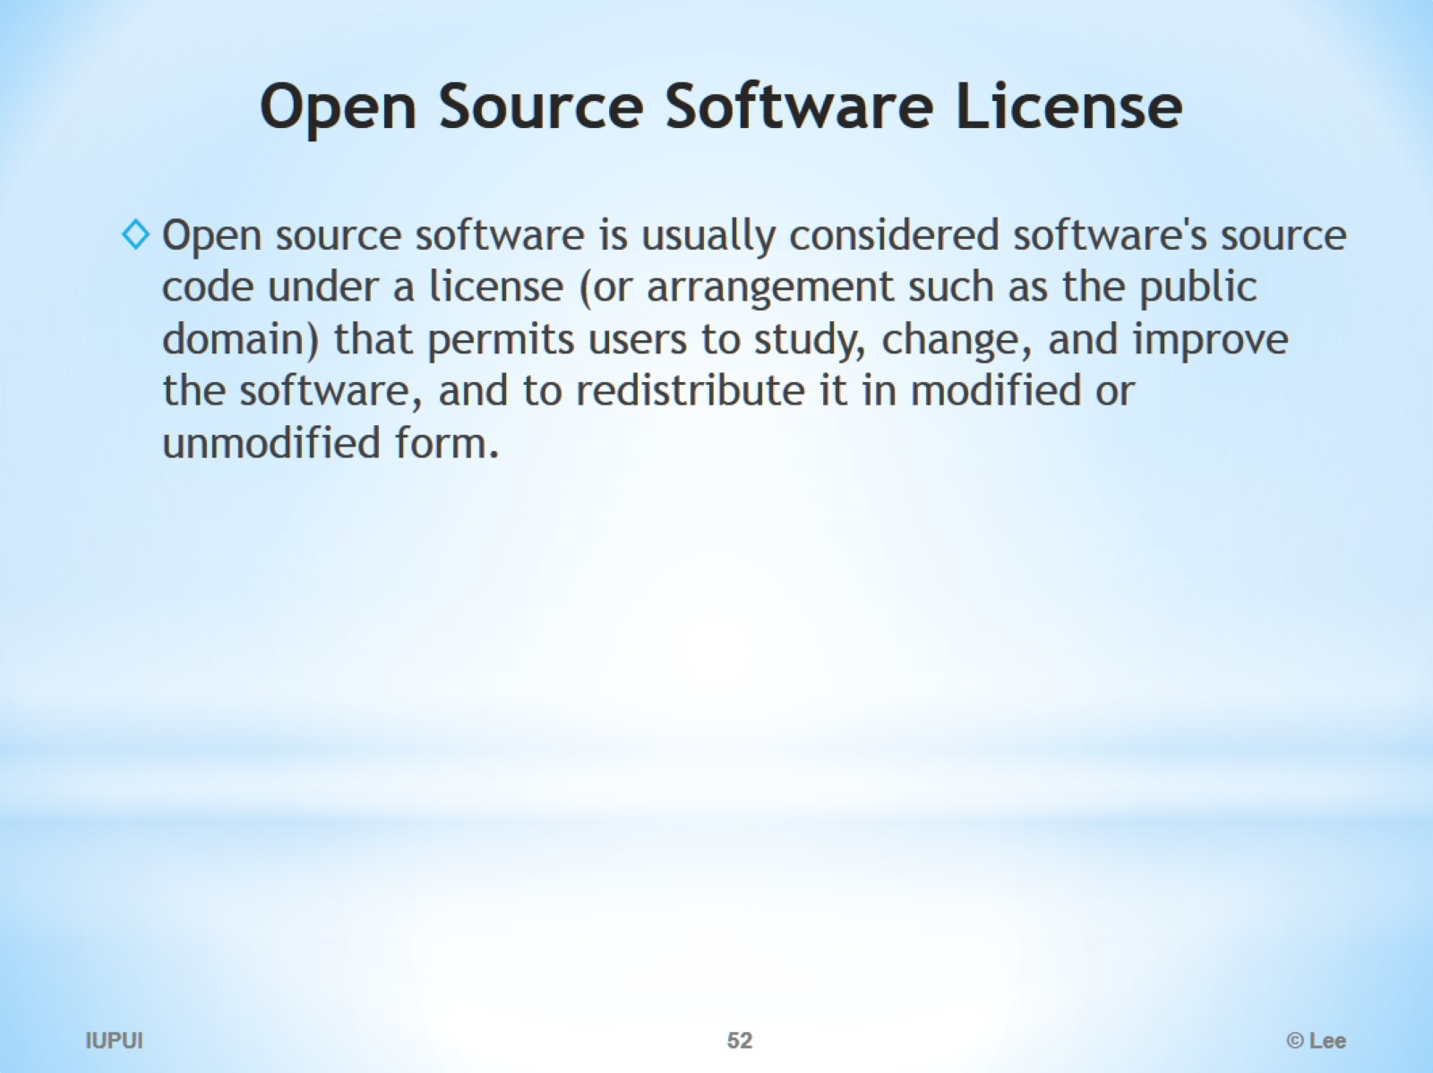
Open Source Software License

Slide 53
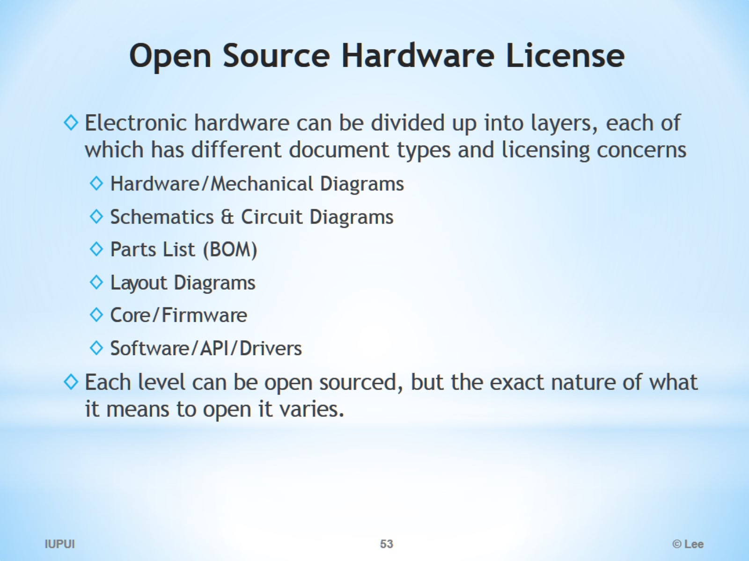
Open Source Hardware License

Slide 54

Business models

